Slide 1
Skeletal System

Slide 2
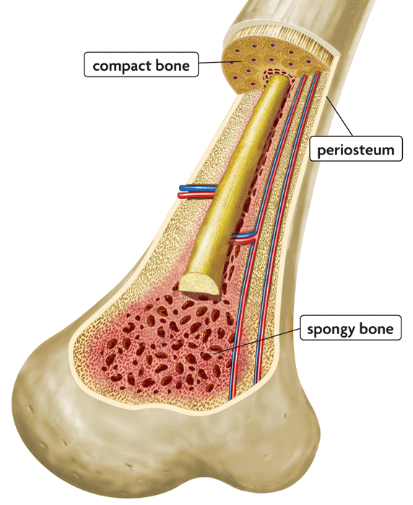
Functions of the Skeletal System
Protection
Body movement
Fat storage- yellow marrow
Blood cell formation = hematopoiesis
Storage of inorganic materials
(calcium, phosphorus)

Slide 3
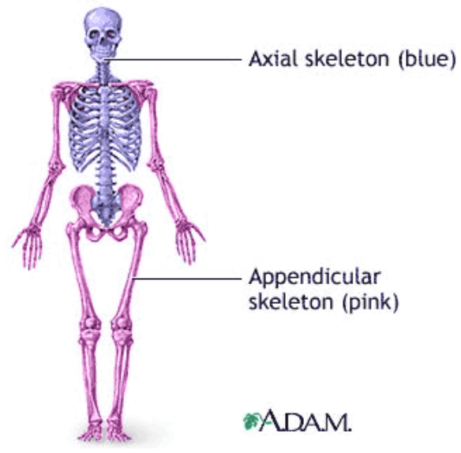
ORGANIZATION
About 206 bones
2 Main Divisions – Axial - protection Appendicular- aid in movement

Slide 4
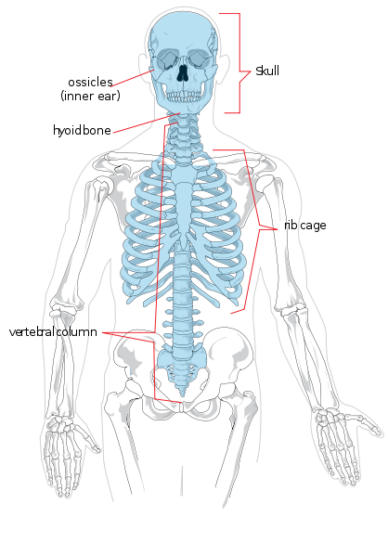
Axial Skeleton
Head, neck, trunk
Skull
Hyoid Bone
Vertebral Column
Thoracic Cage (ribs, 12 pairs)
Sternum

Slide 5
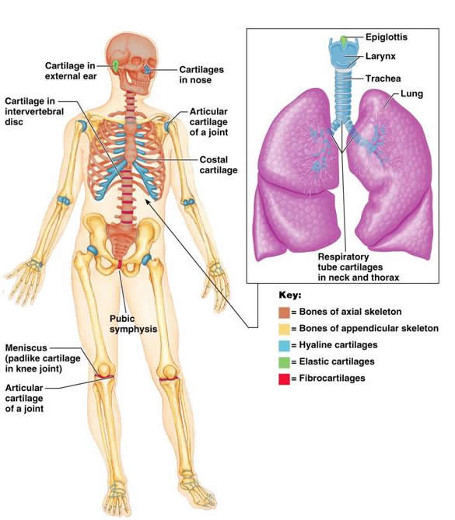
Don’t forget about cartilage
Lays down the original
Skeletal which is quickly
Replaced by bone.

Slide 6
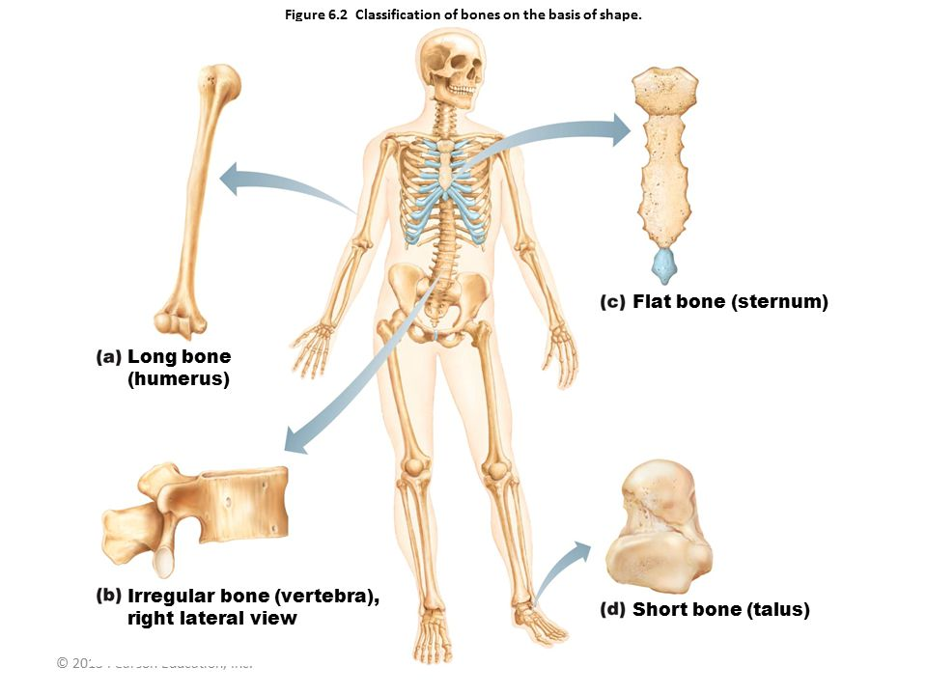
Classifications of Bone
Long Bones- longer than they are wide. Limbs except patella and carpals/tarsals.
Short Bones- wrist /ankle/ sesamoid
Flat bones- Sternum / Scapula / ribs / skull
Irregular Hips/ vertebrae

Slide 8
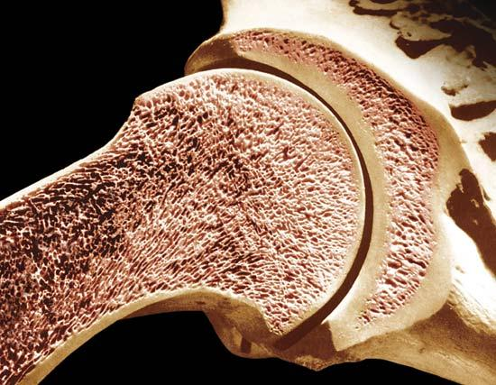
Types of Bone Tissue
Compact – external layer
Spongy (trabecular) – filled with bone marrow

Slide 10
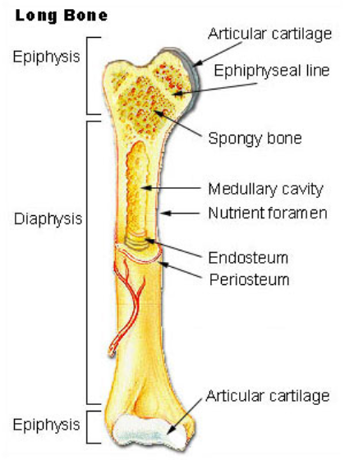
BONE STRUCTURE - Long Bone
Are bones Organs?
1. Epiphysis (end)
2. Articular Cartilage
(hyaline cartilage, padding)
3. Epiphyseal plate (metaphysis)- disc of hyaline where dia. and epi meet.
4. Diaphysis (shaft) – thick compact
5. Medullary Cavity- Yellow Marrow
6. Membranes-
Periosteum – white membrane around external
Endosteum- Internal
Notes:
Muscle in blood vessels

Slide 11
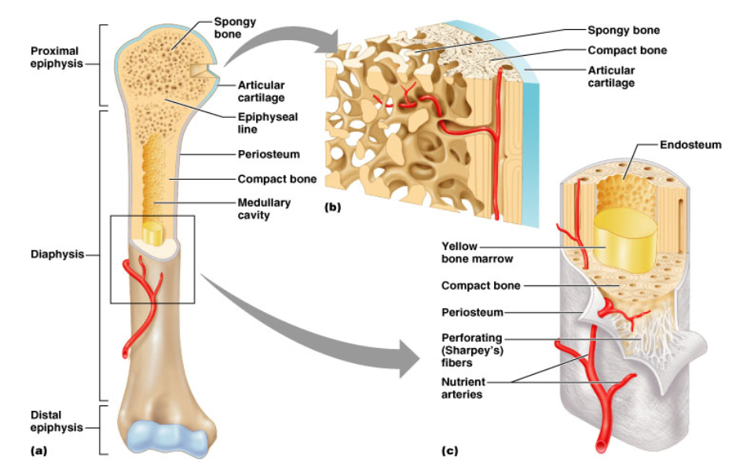
Structure of a Long Bone
Figure 6.3a-c

Slide 12
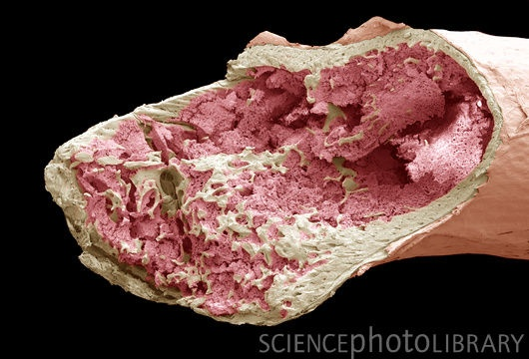
Inside the Long Bone
Medullary Cavity – hollow chamber filled with bone marrow
Red Marrow (blood)
-Sternum
- Skull
- Hips
- Heads of femur and humerus
-Vertebrae
- Scapula
Endosteum
– lining of the medullary

Slide 13
Cells of Bone Tissue
Osteoprogenitor cells (osteogenic)- stems cells in periosteum or endosteum. Become Osteoblasts.
Osteoblasts- form bone matrix, secrete collagen.
Osteocytes- Mature bone cells. Monitor bone matrix. Form rings for blood vessels. Haversian canals.
Osteoclasts- Giant, multinucleated cells. Secrete enzymes to resorb (break down) bone.

Slide 14
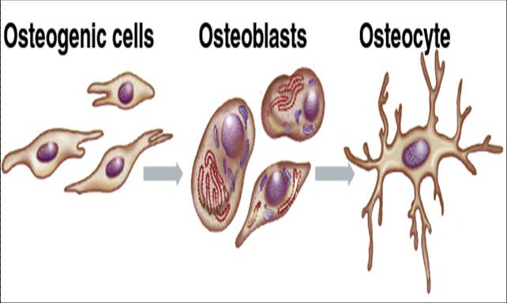
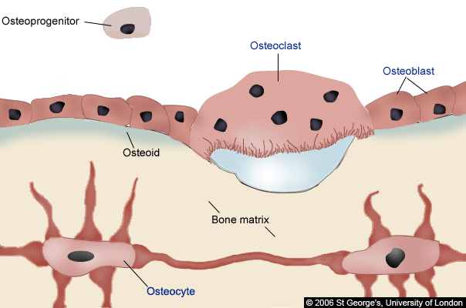

Slide 15
Compact Bone
Osteon- Primary unit of bone. Elongated cylinders running parallel to each other.
Lamella- each ring of bone.
(collagen runs in the patterns)
-Greatly increased strength to
twisting
Canals- Haversian canal.
Center for blood vessels and nerve
Lacunae- Where osteocytes live.
Between lamellae.

Slide 16
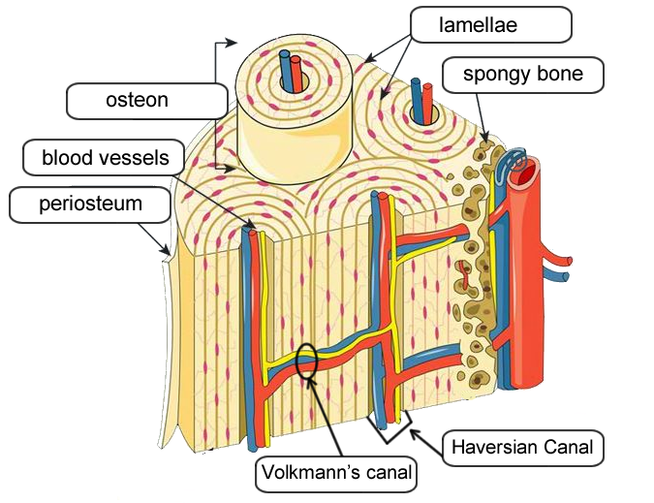
Osteocytes
Haversian Canal
Volkmann’s Canal

Slide 17
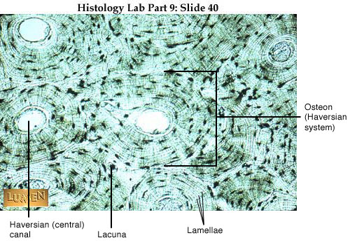

Slide 18
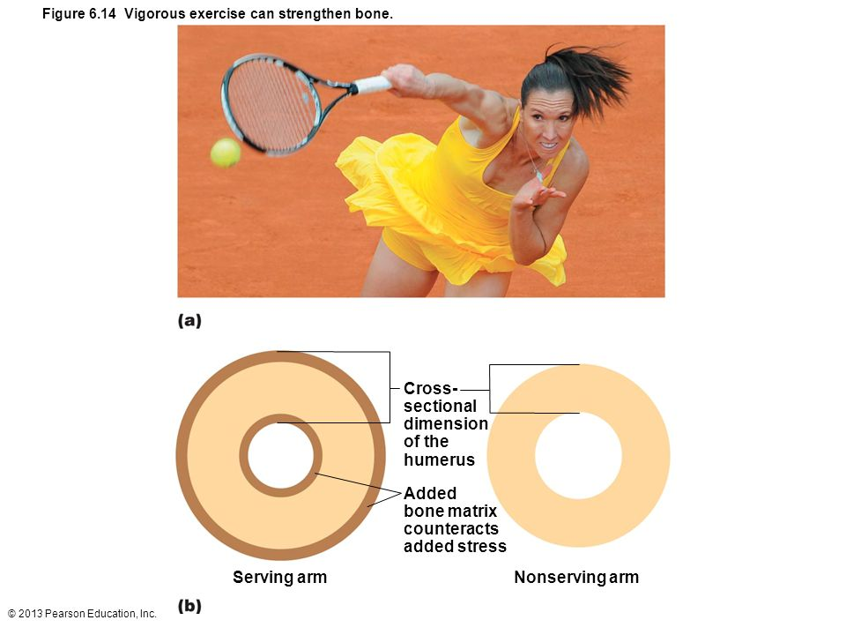
Bone Remodeling
Spongy bone – 3-4 years
Compact bone – 10 years +
Not uniform – Distal femur every 5-6 months, shaft very slow.
Balance of Osteoclasts resorbing bone and osteoblasts building
Wolff’s Law- Bone remodels in
response to stresses.
- explains why large bony
projections occur where muscles
attach
- Also why bedridden people
lose bone mass.

Slide 19
Bone Fracture Types

Slide 20
Bone Fracture Types

Slide 21
Bone Fracture Types

Slide 22
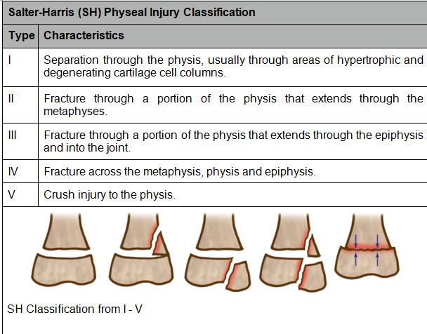

Slide 24
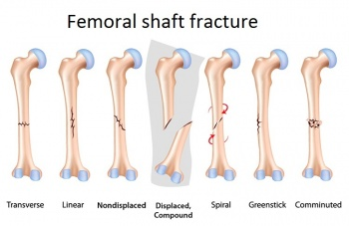

Slide 25
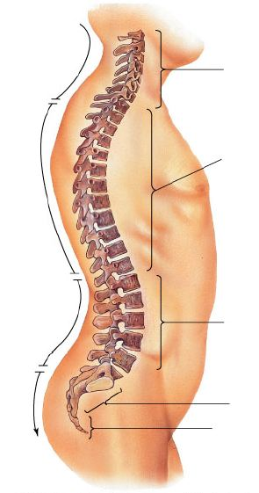
Vertebrae
Neck = cervical
Middle Back = thoracic
Lower Back = lumbar

Slide 26
BONE DEVELOPMENT & GROWTH
Bones first form as hyaline cartilage. The cartilage then gradually changes into bone tissue - a process called OSSIFICATION
Intramembranous bones – flat, skull
Endochondral bones – all other
- Bone develops from hyaline cartilage
WHY CARTILAGE?

Slide 27
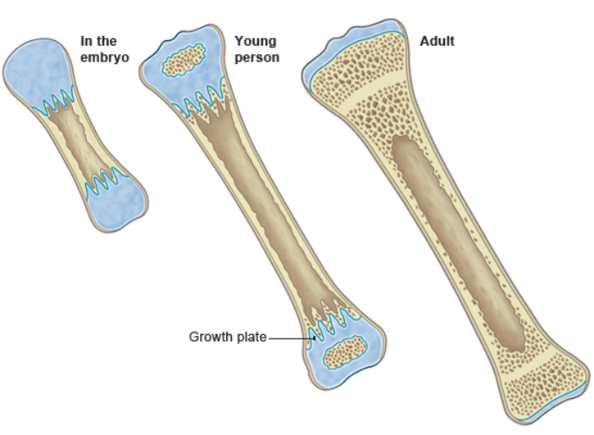
Bone Growth

Slide 28
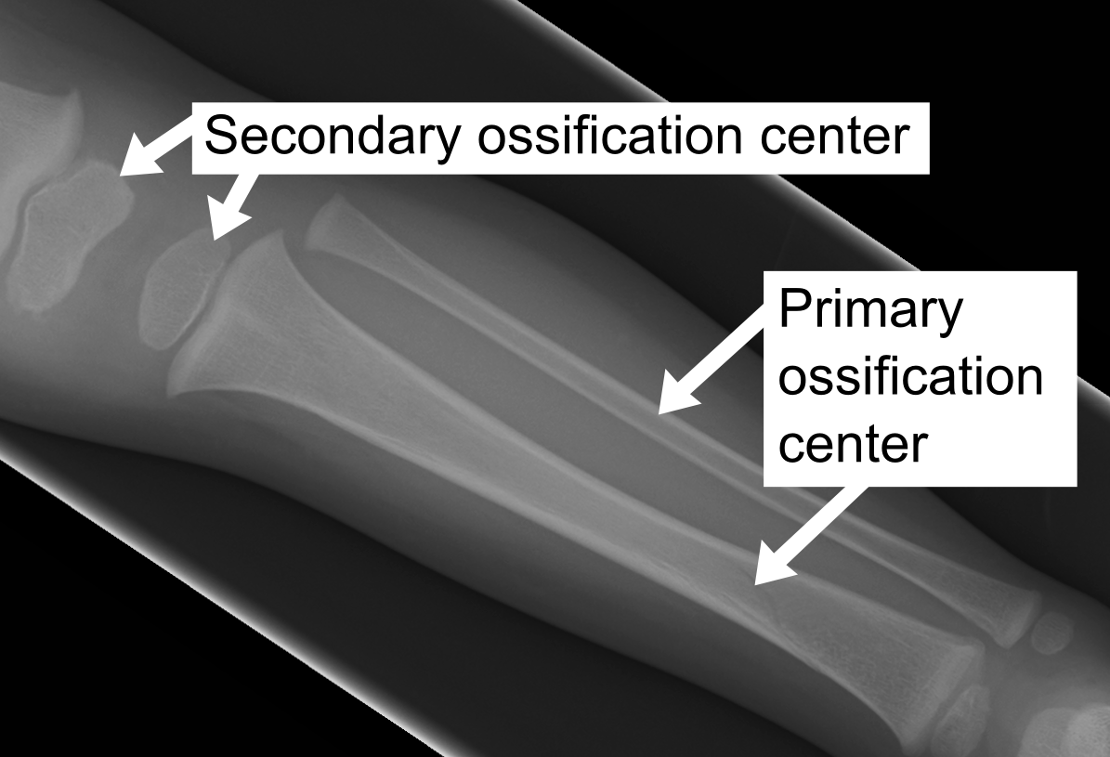
Ossification Zones
PRIMARY OSSIFICATION CENTER (shaft)
SECONDARY OSSIFICATION CENTER (ends)

Slide 29
Growth of bone
Length- Depends on open growth plate.
- Push the epiphysis further from the shaft.
- Chondrocytes die and are digested by osteoclasts and replaced by osteoblasts.
Thickness- osteoblasts secrete bone matrix on the outside of the diaphysis while osteoclasts remove older bone.

Slide 30
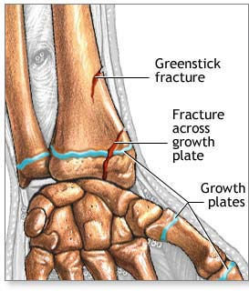
Bone Development & Growth
EPIPHYSEAL DISK (growth plate) is a band of cartilage between the epiphysis and diaphysis
These areas increase bone length during growth.

Slide 31
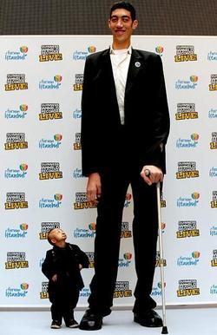
Regulation of bone growth
Growth Hormone- from anterior pituitary.
- Excess production = gigantism
- not Enough – dwarfism
Sex hormones- trigger growth spurt in
beginning of puberty and epiphyseal
closure to end bone growth.

