Slide 1
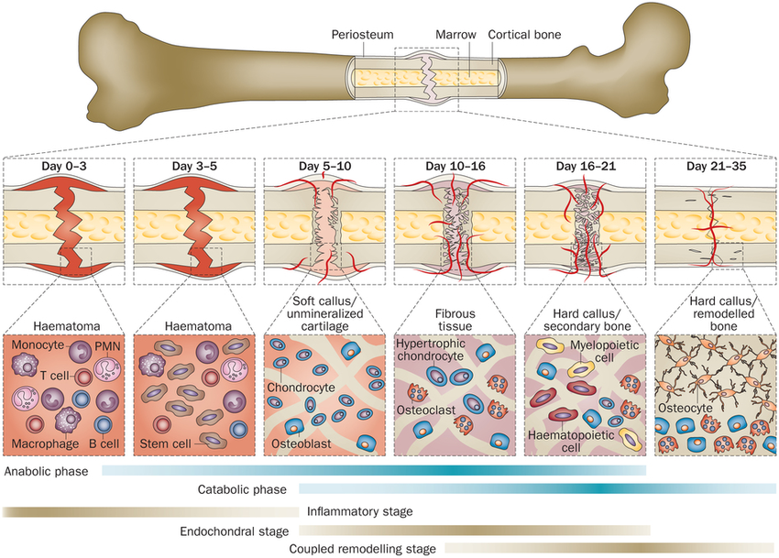
Bone Repair
Notes:
6-8 weeks for healthy longer for fermur elderly.

Slide 2
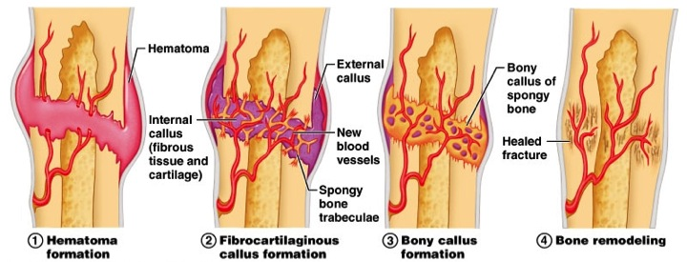
Fracture Repair

Slide 3
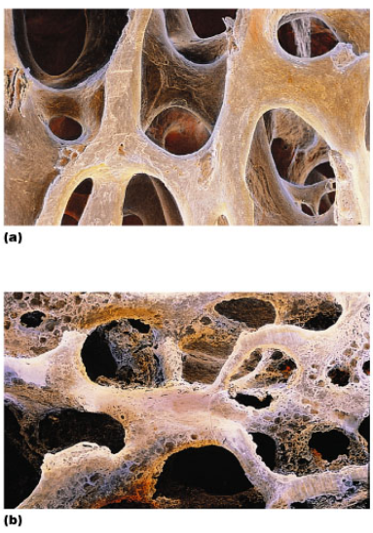
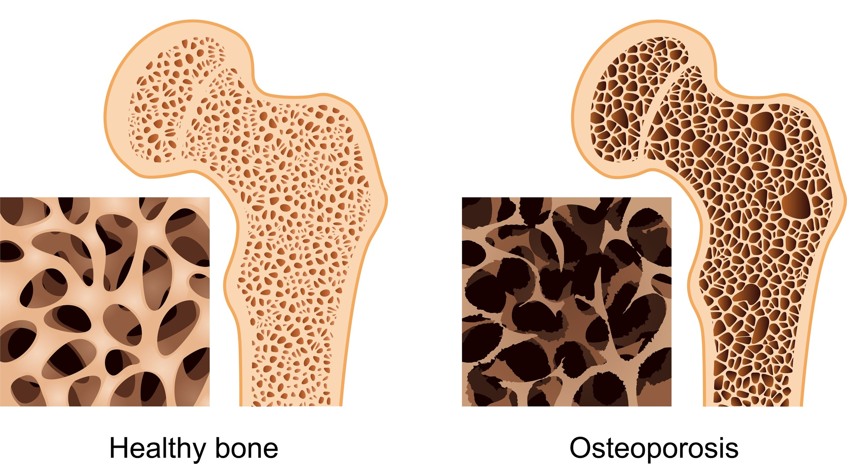
OSTEOPOROSIS: Increased activity of osteoclasts cause a break down bone, bones become more fragile
The spongy bone especially becomes more porous, especially spine and neck femur

Slide 4
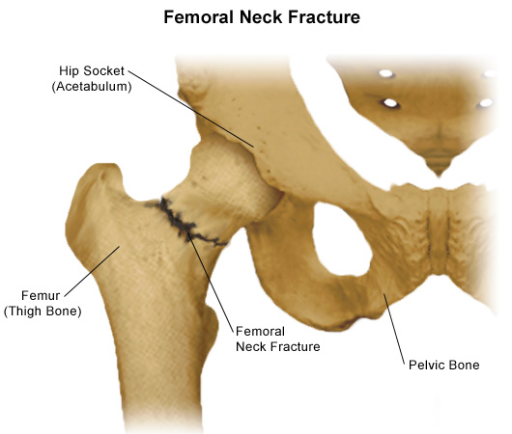
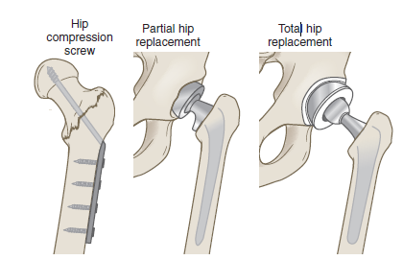
Why do older people break their hips?
A femoral neck fracture is common among older adults and can be related to osteoporosis. This type of fracture may cause a complication because the break usually cuts off the blood supply to the head of the femur.

Slide 5
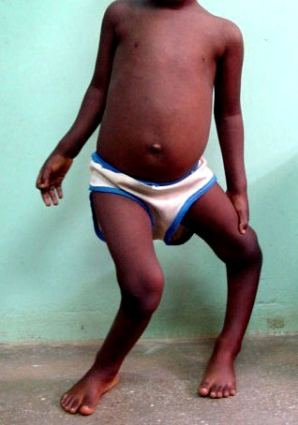
Osteomalacia
Poorly mineralized bones, pain in bones.
Rickets- in children. Bowed legs and deformities.
Caused by insufficient calcium or
vitamin D in diet.

Slide 6
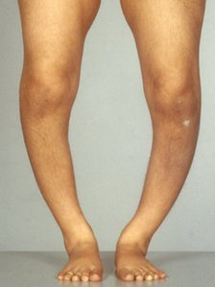
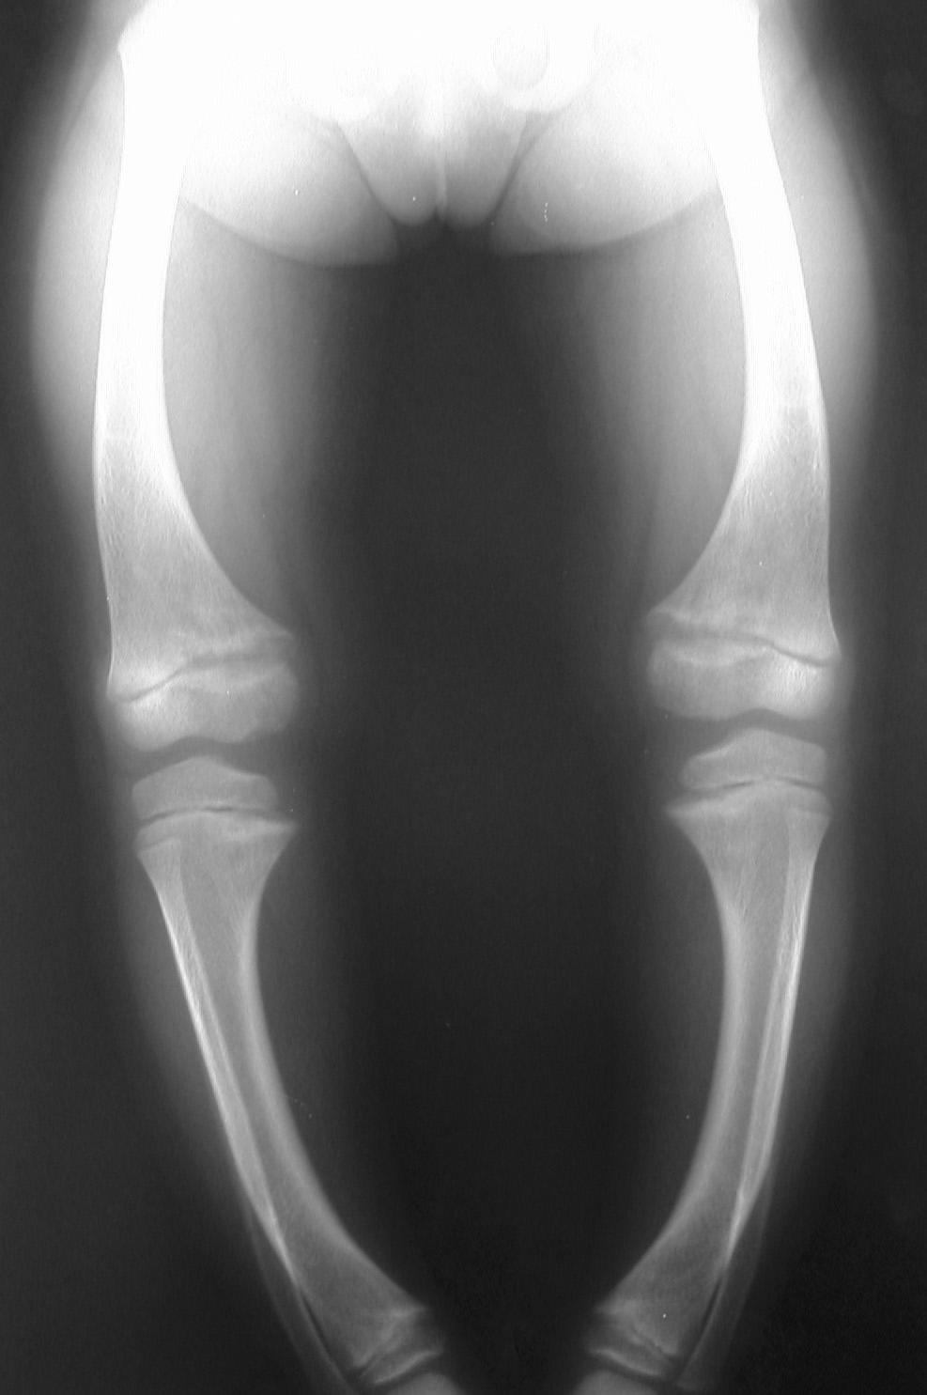
4. Rickets
This preventable bone disease affects young children and is caused by a deficiency of the nutrient vitamin D. Rickets causes weak, brittle bones that fracture easily and bone and muscle pain.

Slide 7
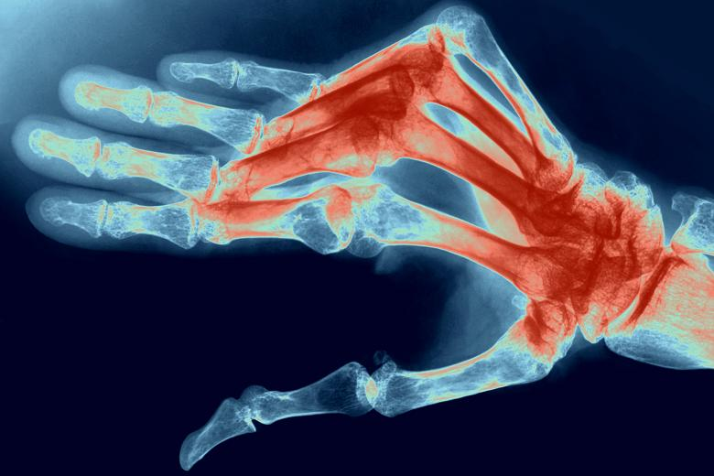
4. Rheumatoid arthritis is an autoimmune disease which causes joint stiffness and bone deformity
Source: http://www.thetimes.co.uk/tto/public/article3233439.ece

Slide 8
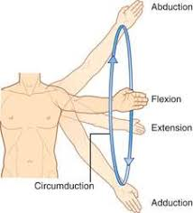

Slide 9
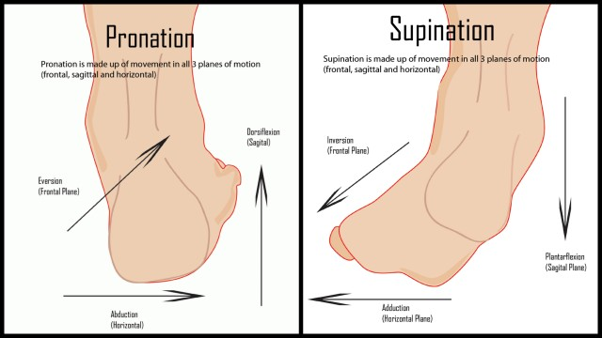

Slide 10
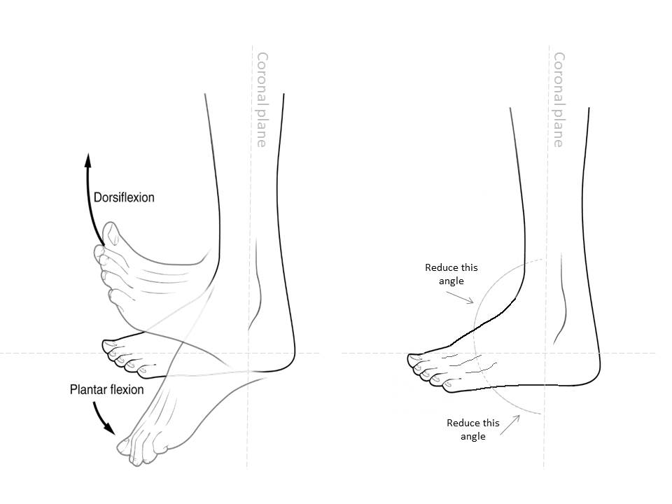

Slide 11
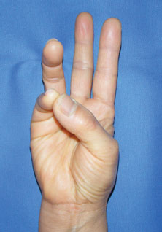
Opposition

Slide 13
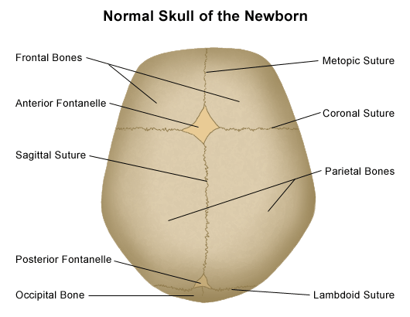

Slide 14
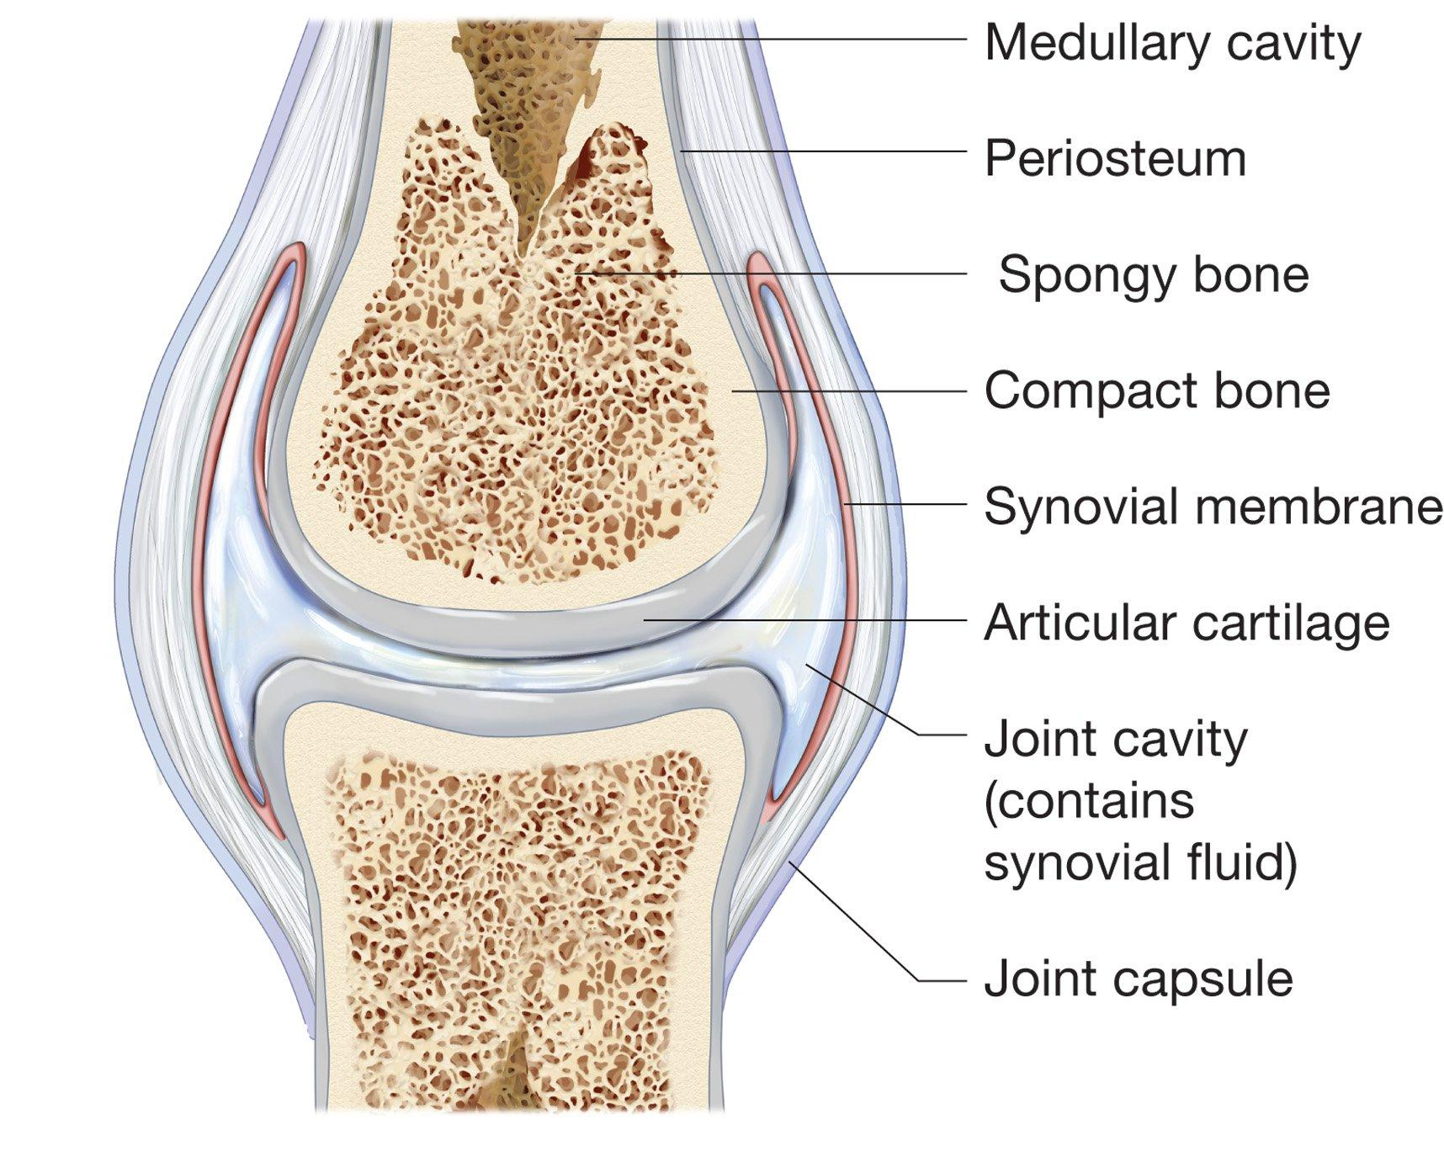
The synovial joint
Notes:
Remember ligament tendon. Remember synovial one of 4 types of membranes in body. This one like serous but without epithelial membrane.

Slide 15
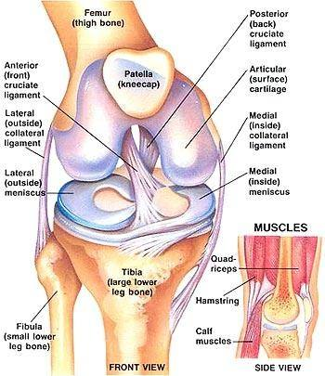

Slide 17
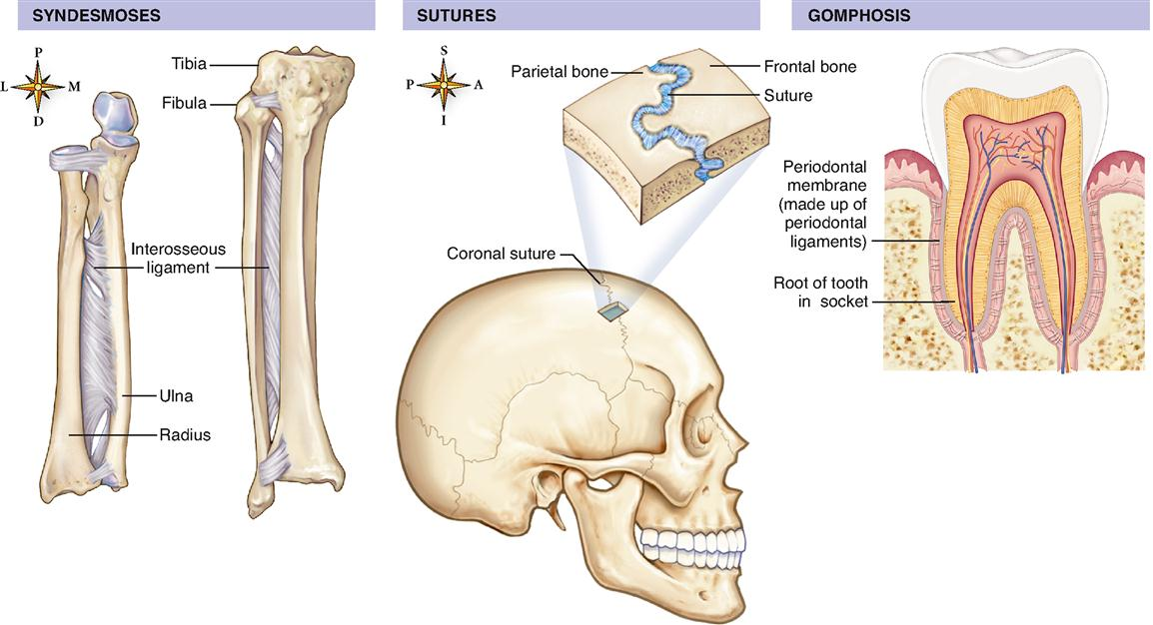
Structural classification
Fibrous joint- bones are joined by fibrous connective tissue.
- ex. Sutures, teeth

Slide 18
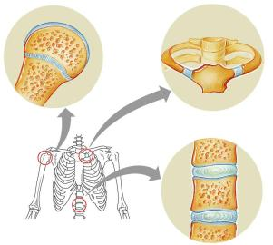
Structural classification of Joints
Cartilaginous joint- Bones are in contact with each other through hyaline cartilage or fibrocartilage.
- ex. IVD, Pubic symphysis, Sacrum

Slide 19
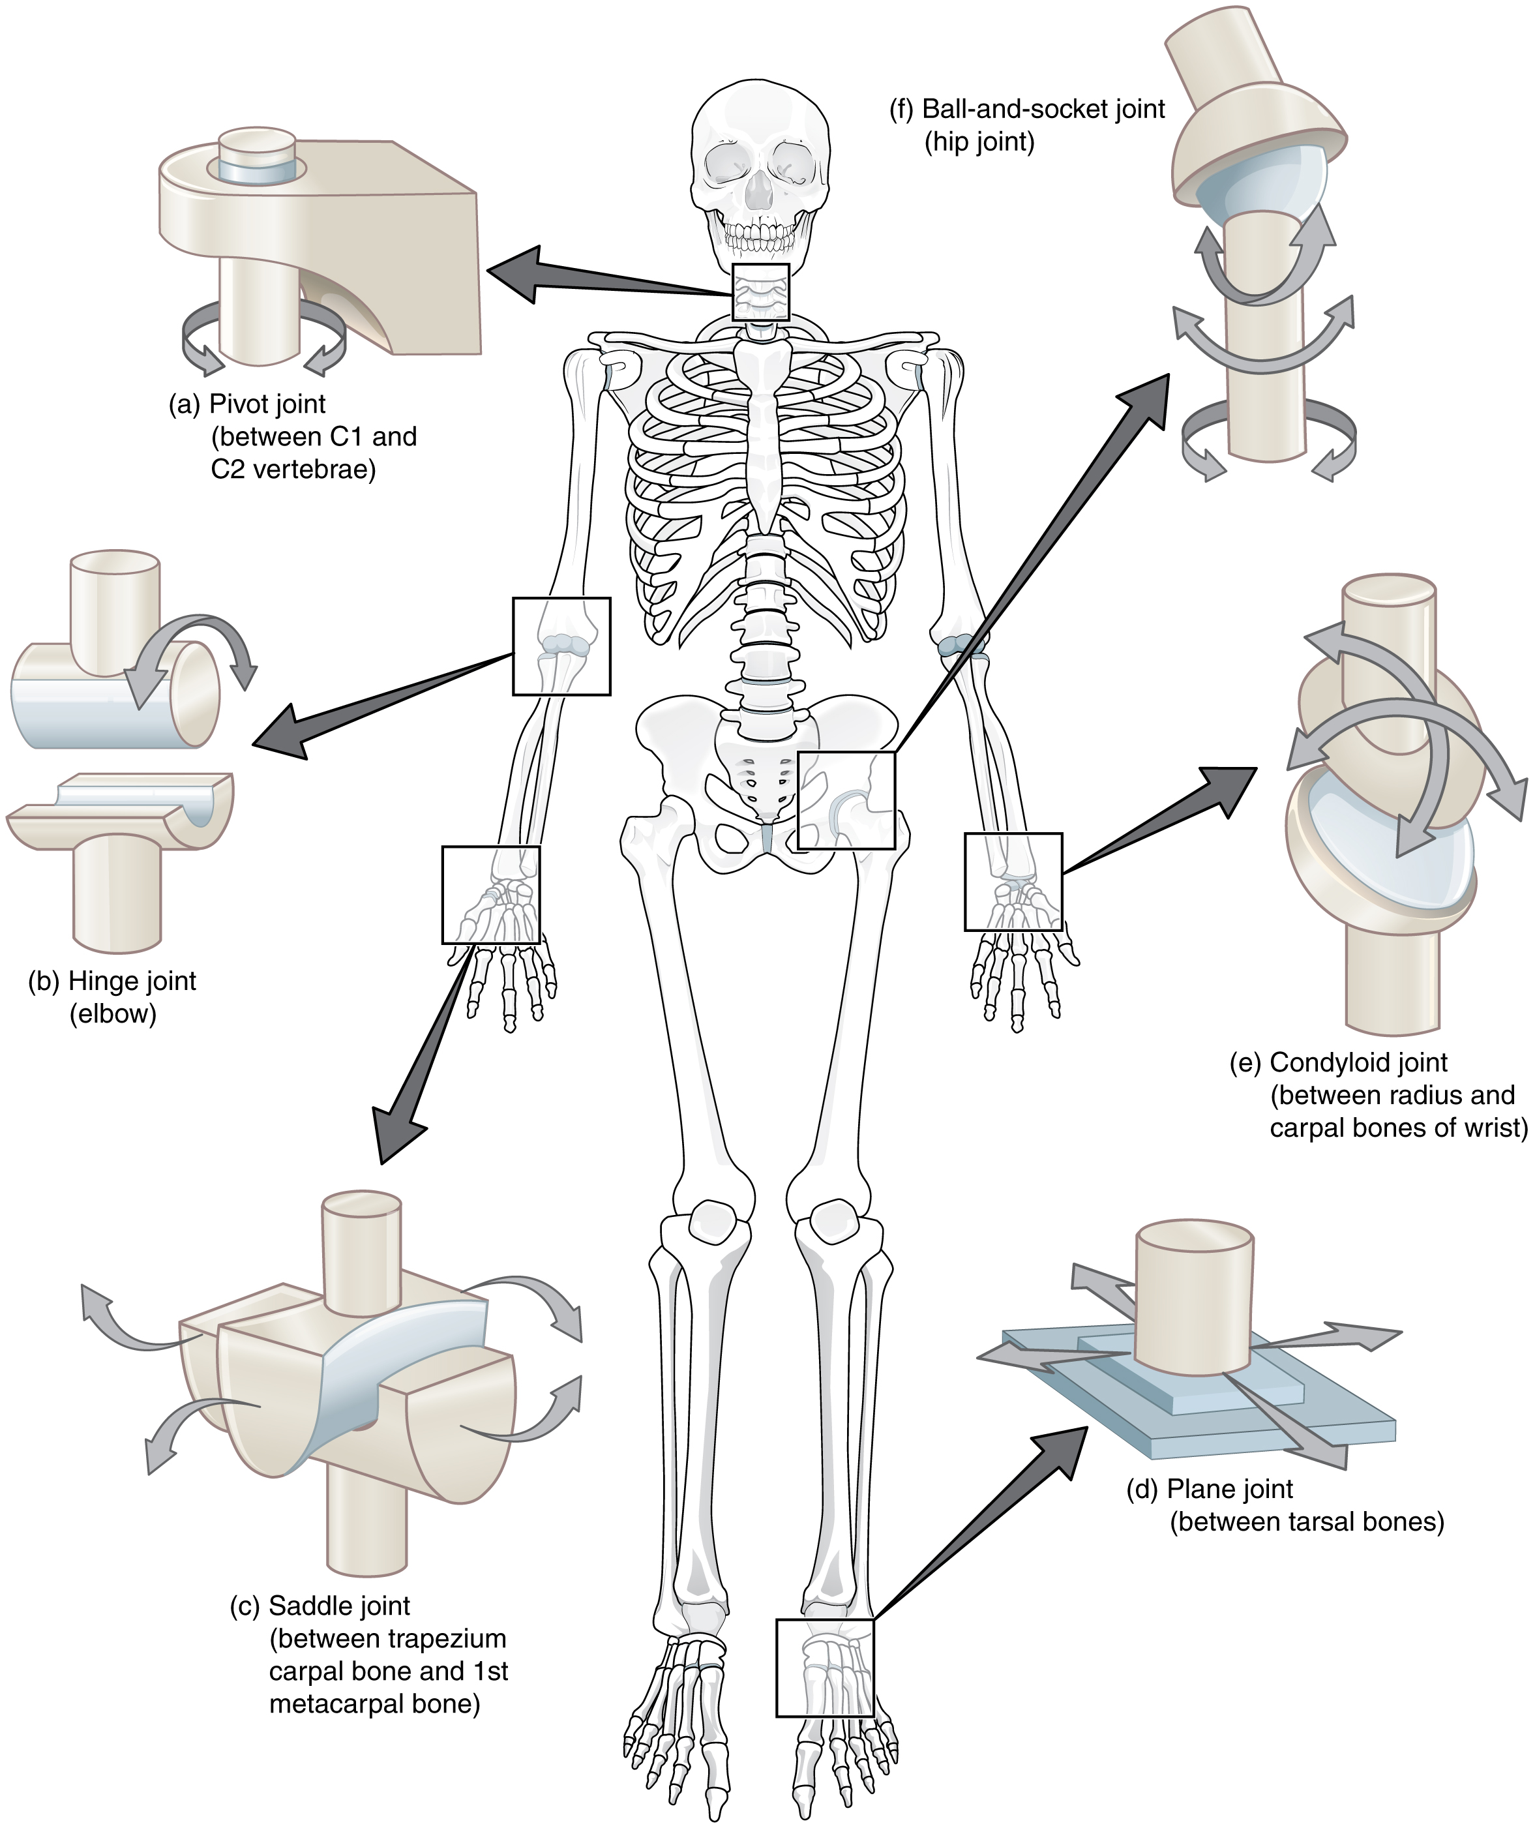
Structural classification of Joints
Synovial Joint- the bones are not directly
connected. Fluid filled capsule.
- ex. Joints of movement

Slide 20
The synovial joint
Notes:
Remember ligament tendon. Remember synovial one of 4 types of membranes in body. This one like serous but without epithelial membrane.

Slide 21
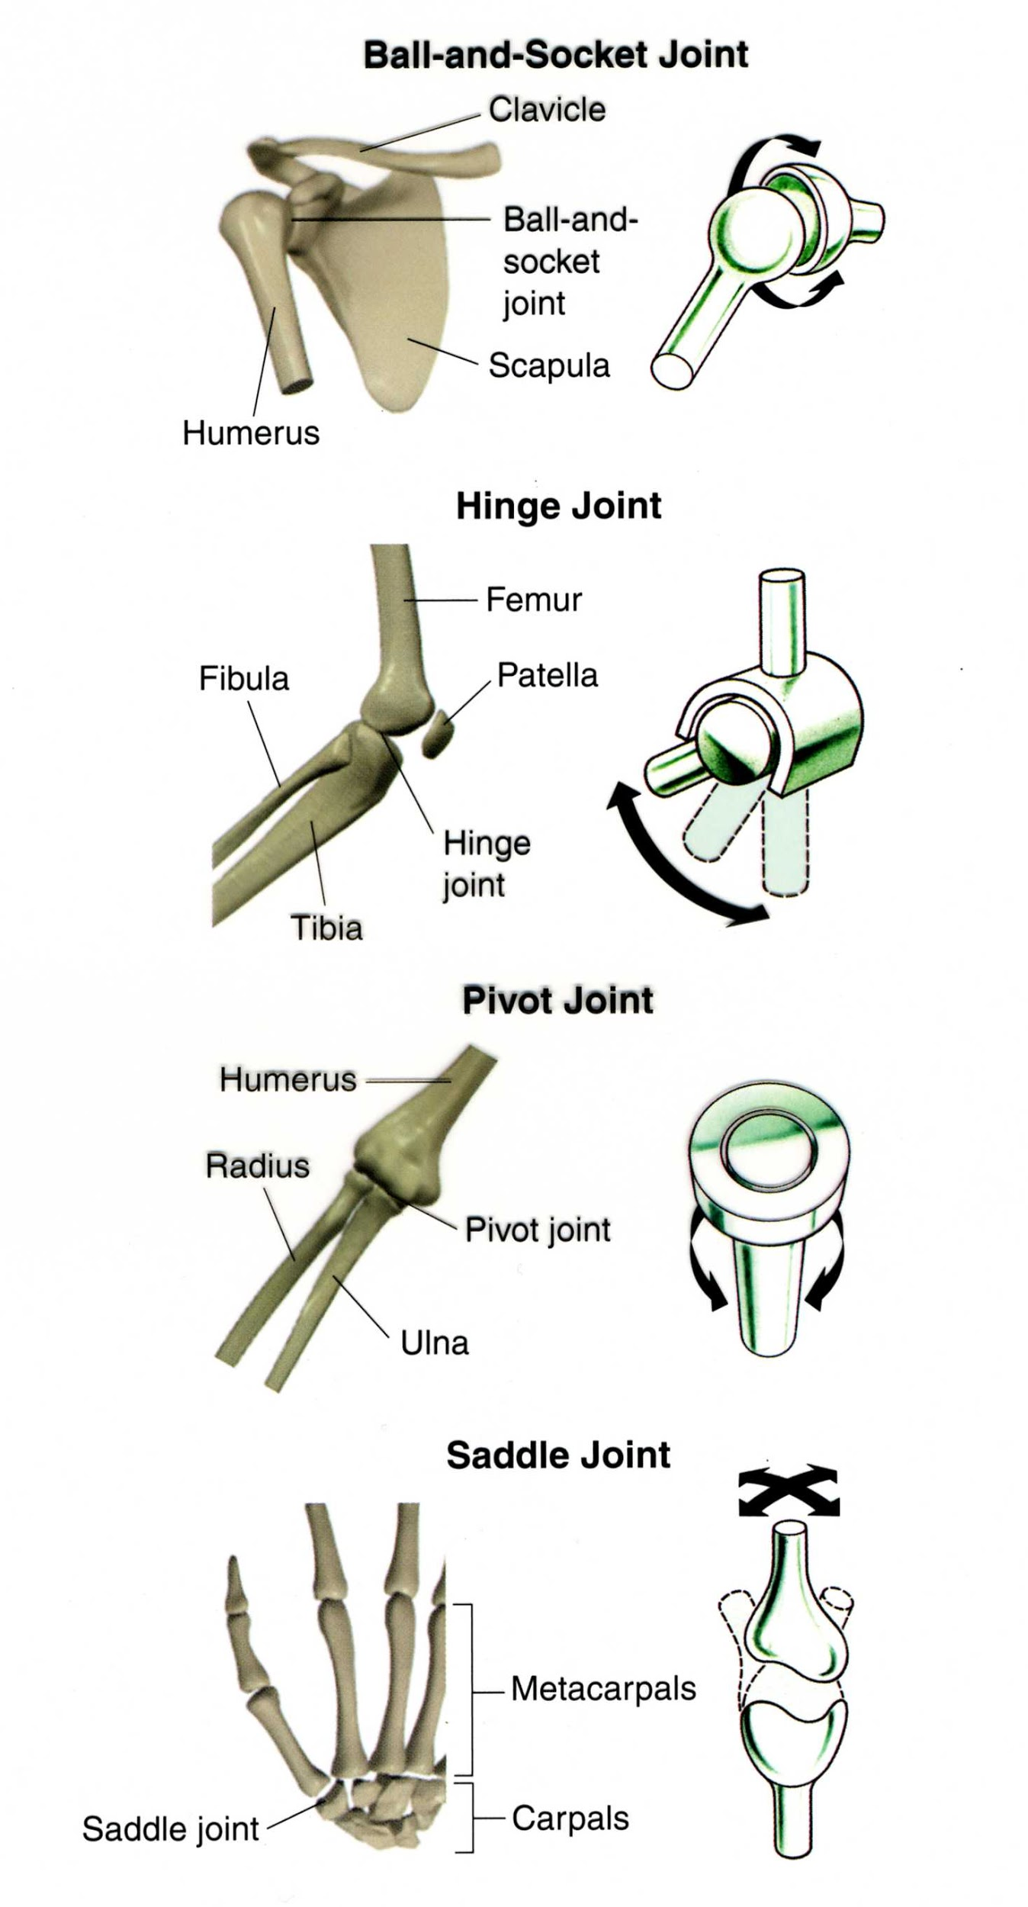
Types of Synovial Joints
1. Ball and Socket
(shoulder / hip)
2. Hinge (elbow, knee)
3. Pivot (lower arm)
4. Saddle (thumb)

Slide 22
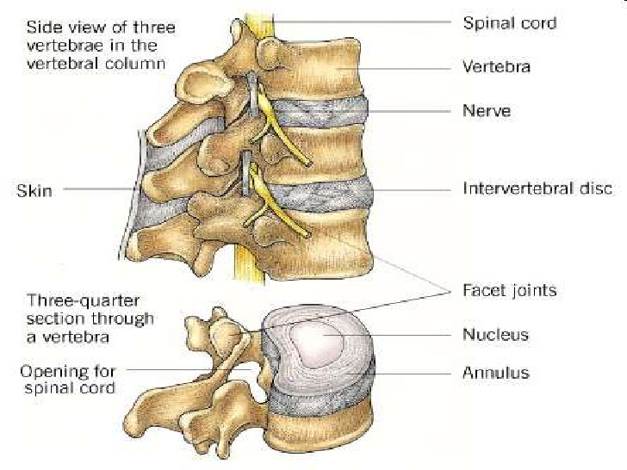
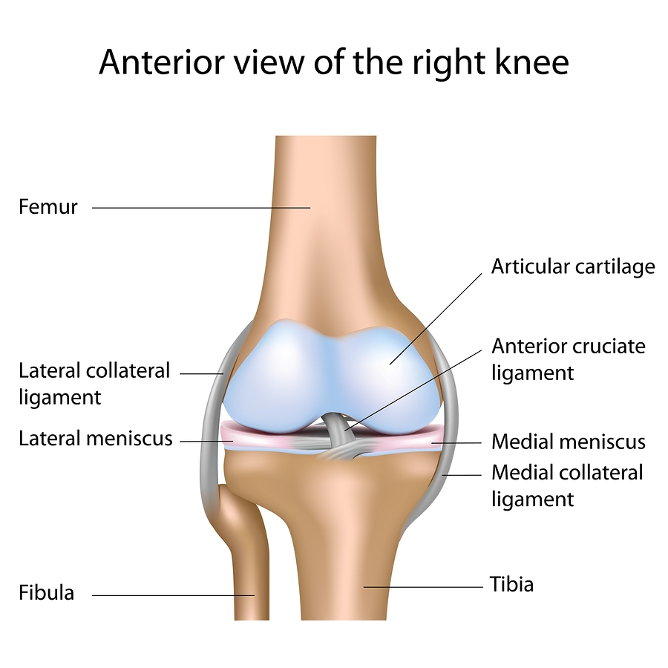
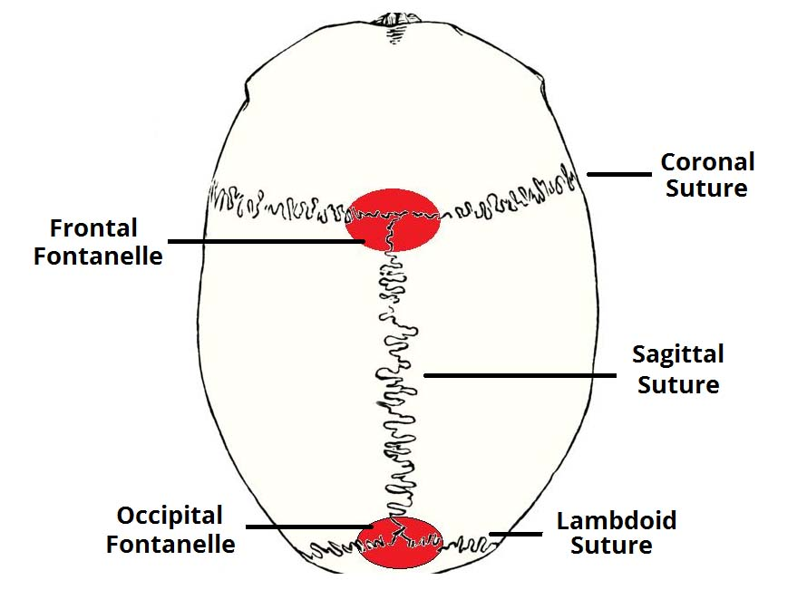
Practice
What structural / type of joint?

Slide 23
