Slide 2
The Nervous System

Slide 3
Brain Fact
It is estimated that the human brain contains 100 billion interneurons averaging 1000 synapses on each; that is, some 10¹⁴ connections. If you had 10¹⁴ pennies, how much money would you have?
Notes:
100 trillion

Slide 4
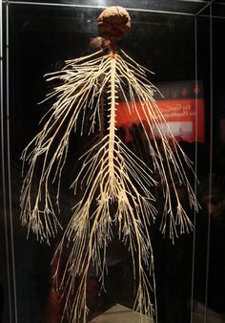

Slide 5
Functions of the Brain?

Slide 6
The Nervous system has three major functions:
Sensory – monitors internal & external environment through presence of receptors
Integration – interpretation of sensory information (information processing)and deciding what should be done (integrating)
Motor – response to information processed through stimulation of effectors
Notes:
What could effectors be

Slide 8
General Organization of the nervous system
Two Anatomical Divisions
Central nervous system (CNS)
Brain
Spinal cord
Which body cavity?
Peripheral nervous system (PNS)
All the neural tissue outside CNS
Afferent division (sensory input)
Efferent division (motor output)
Somatic nervous system
Autonomic nervous system

Slide 9
Somatic and Autonomic
Somatic nervous system- impulses from CNS to skeletal muscles.
Voluntary
Autonomic (ANS) –regulates smooth muscle, cardiac muscle, and glands.
Involuntary
Sympathetic- Flight of Fight
Parasympathetic- Rest and Relax

Slide 10
Histology of neural tissue
Two types of neural cells in the nervous system:
Neurons - For processing, transfer, and storage of information
Neuroglia – For support, regulation & protection of neurons

Slide 11
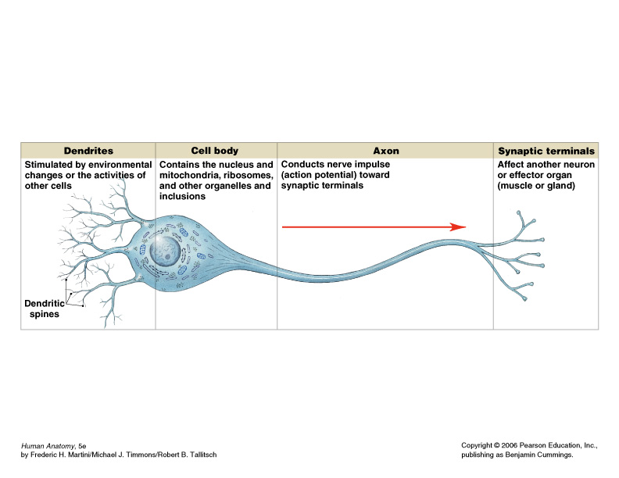
Neuron structure

Slide 12
Neuron processes
Dendrites- short, highly branched extensions close to the cell body
- Increase Surface area for sensory reception
2. Axons- each neuron has one axon.
- Generate and transmit AP away from cell body
- Can be long. Longest cell of your body is the axon of the motor neuron to your big toe from your back.
- Ends in the axon terminals- release neurotransmitters which can either excite or inhibit the nearby cells.
Bundles of neuron processes are called:
Tracts- in the CNS
Nerves – in the PNS

Slide 13
Neuron structure
Can live up to 100 years
Amitotic- lose their ability to divide once assigned a role.
High metabolism rate- need lots of oxygen and glucose, will die within minutes.
Cell Body- Nucleus and cytoplasm AKA Soma
Form clusters in the body
- called nuclei in CNS
- called ganglia in the PNS

Slide 14
Neurons
Look back to your pictures of the neuron that you drew, what are the main parts of a neuron?

Slide 15
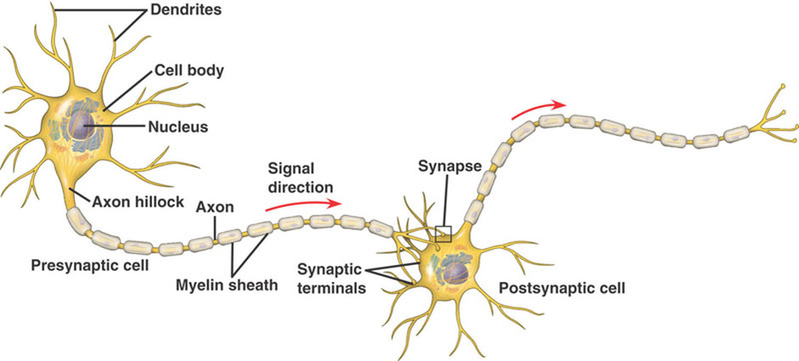
Neuron structure

Slide 16
Neuron structure
Cell body- nucleus, ER, Golgi, Mitochondria
Most located in the CNS
Nuclei in the CNS
Ganglia in the PNS
Dendrites- Impulses toward cell body (not action potentials)
Highly branched
short in motor neurons, long in sensory neurons
No myelin sheath
Axon- impulses (AP) away from cell body
Only one in every neuron, beginning at hillock
End as thousands of axon terminal branches
release neurotransmitters which can either excite or inhibit the nearby cells.
Notes:
Atp- active transport proteins- neurotransmitters in crease SA graded potentials

Slide 17
Neuroglia (glial cells)
CNS neuroglia:
astrocytes
oligodendrocytes
microglia
ependymal cells
PNS neuroglia:
Schwann cells (neurolemmocytes)
satellite cells

Slide 18
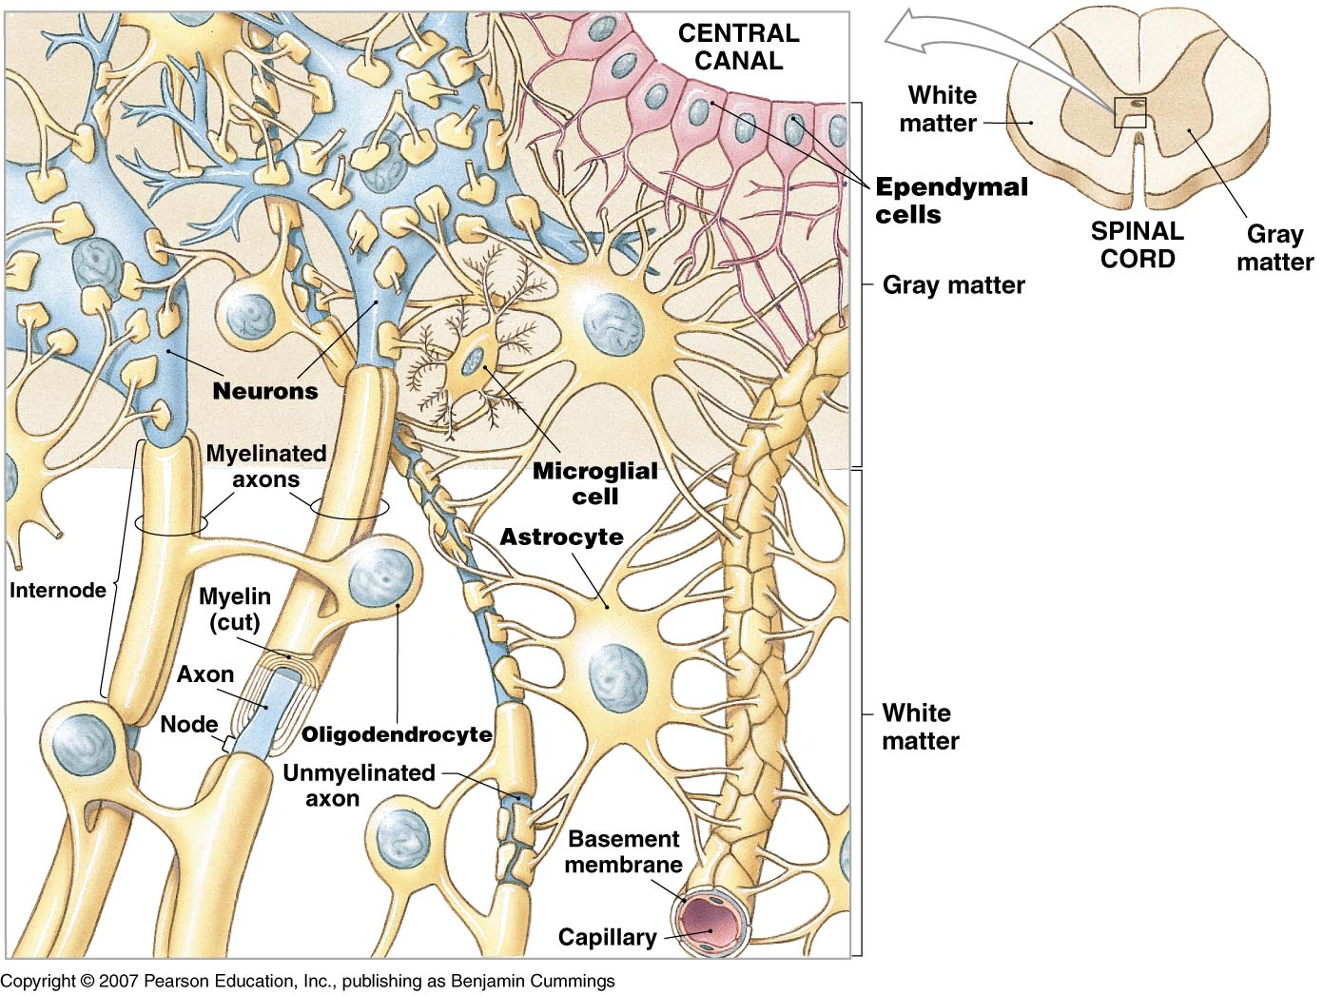
Astrocytes
create “blood-brain barrier”
Anchor neurons nearby blood supply.
Recycle neurotransmitters and ions
May participate in brain processing

Slide 19
The Blood Brain Barrier

Slide 20
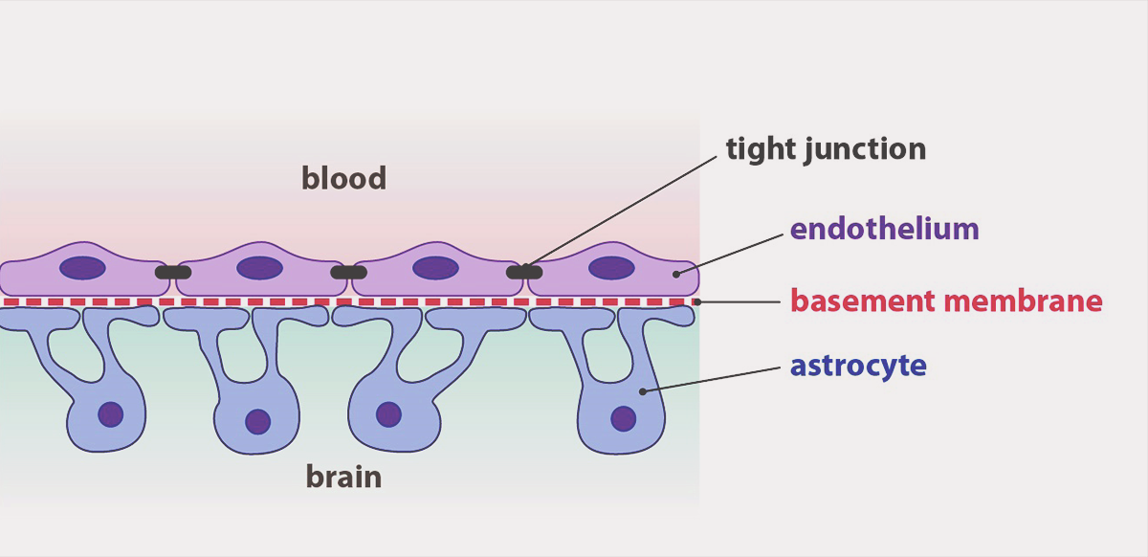
The Blood Brain Barrier
Made by:
1. Tight junction between blood vessel endothelial cells
2. Astrocytes “feet” add additional protection
Purpose
Protections of brain from toxins

Slide 21
Oligodendrocytes
create myelin sheath around thicker axons of neurons in the CNS. -------Myelinated axons transmit impulses faster than unmyelinated axons
Microglia
“brain macrophages”
phagocytize cellular wastes & pathogens
Monitor nearby neuron health.

Slide 22
Ependymal cells
line ventricles of brain & central canal of spinal cord
produce, monitor & help circulate CSF (cerebrospinal fluid)

Slide 23
Cerebrospinal fluid
Line cavities of brain and spinal cord
Liquid cushion for CNS
Reduces weight by 97% by allowing it to float
Prevents the delicate tissue from crushing under its own weight.
Also provides some nourishment
Replaced every 8 hours

Slide 24
Glial cells of the PNS
Schwann cells- Create myelin sheath in the PNS. Can possibly aid in regeneration of peripheral nerve.
Satellite cells- Surround peripheral neuron cell bodies and anchor them

Slide 25
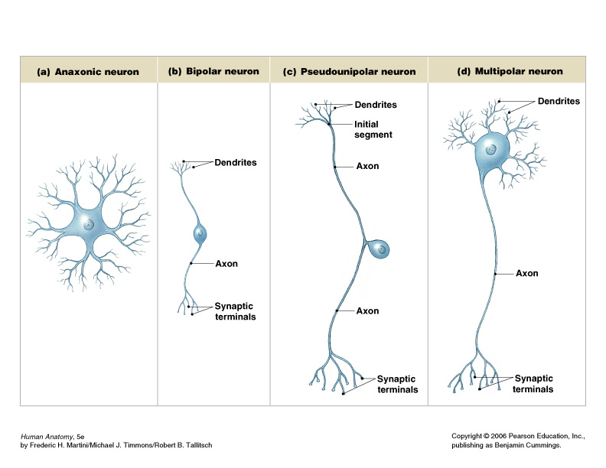
Classification of neurons
Structural classification based on number of processes coming off of the cell body:

Slide 26
Classification of neurons
Functional classification based on type of information & direction of information transmission:
Sensory (afferent) neurons –
transmit sensory information from receptors of PNS towards the CNS
most sensory neurons are unipolar, a few are bipolar
Motor (efferent) neurons –
transmit motor information from the CNS to effectors (muscles/glands/adipose tissue) in the periphery of the body
all are multipolar
Association (interneurons) –
transmit information between neurons within the CNS; analyze inputs, coordinate outputs
are the most common type of neuron (20 billion) 99%
are all multipolar

Slide 27
Multipolar neuron
multiple dendrites & single axon
most common type
99%
Major neuron of CNS
Motor neurons

Slide 28
Bipolar neuron
two processes coming off cell body – one dendrite & one axon
only found in eye, ear & nose

Slide 29
Unipolar neuron
single process coming off cell body, giving rise to dendrites (at one end) & axon (making up rest of process)
Sensory neurons in PNS

Slide 30
Meninges
Connective tissue of the CNS
Hold in CSF and blood vessels / protect
Dura Mater- tougher outer layer
Forms falx cerebri that dives into the longitudinal fissure.
Arachnoid Mater- Loose brain covering\
does not go into the sulci
Subarachnoid space- CSF
Pia mater- delicate covering that clings to brain with small arteries

Slide 31
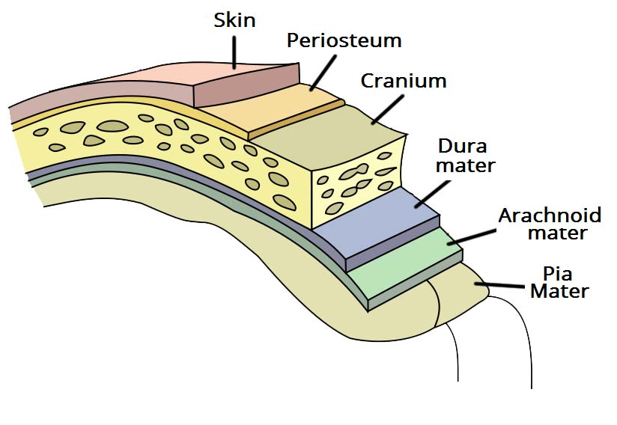

Slide 32
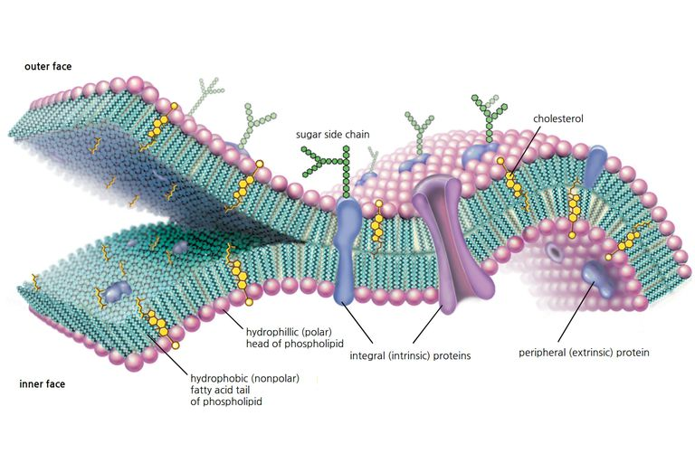
The Cell Membrane
Lipid bilayer
Inside is nonpolar
Heads are polar
Selectively permeable
What can pass through
Water
O2, CO2
Everything else needs a protein
Active or Passive

Slide 33
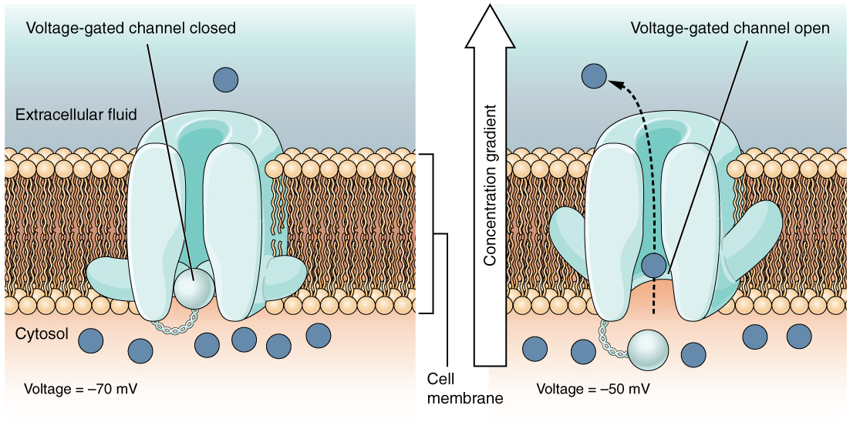
Protein Channels
Pathways through the cell membrane for ions or molecules
Highly Specific for one or two molecules
Can be blocked (gated)
- Opened by either change in voltage, mechanical pressure, or chemical (ligand)

Slide 34
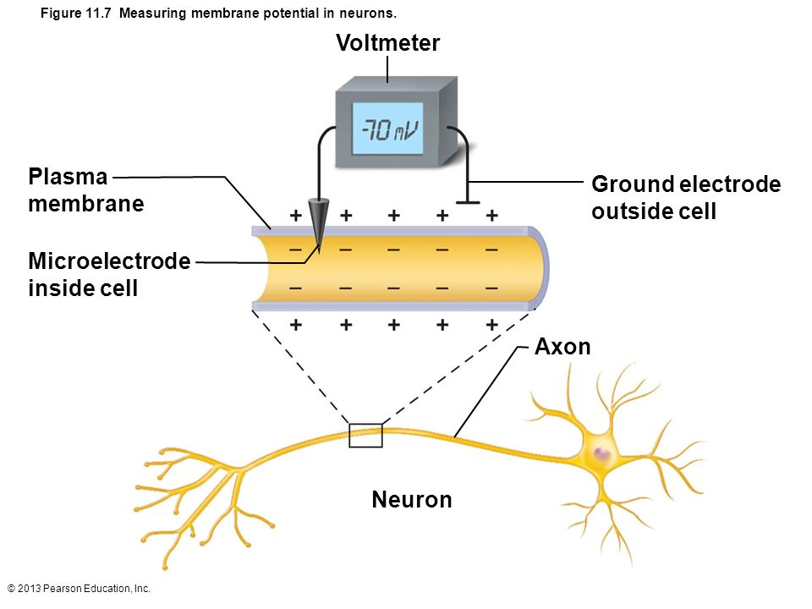
Membrane potential
Human body is neutral, but the difference in charge inside a cell versus outside is often not.
Measured in mV
Depolarize = become more positive
Repolarize = become more negative
Hyperpolarize= negative past -70 mV
Resting membrane potential is about -70 mV

Slide 35
Notes:
Negatively charged proteins. K+ IS more leaky.

Slide 36
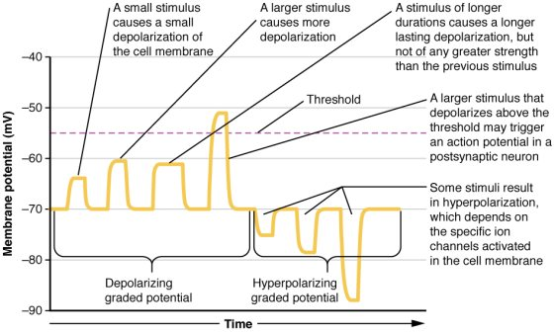
Threshold
Nerves have a threshold to begin the action potential process
Once an AP begins = ALL or NONE
Threshold is about -55 mV in nerves
Why have this?
Dendrites receive the signals

Slide 37
The Action Potential
Phase 1: Threshold is reached
Phase 2: Depolarization
Sodium (Na+) voltage gated ion channels open
Sodium flies into (Passive) nerve cell
Depolarization until about +30 mV
Phase 3: Repolarization
At +30 Mv the voltage gated channels now close for Sodium
Voltage gated Potassium (K+) Channels open
Potassium moves out of the cell (passive) to restore the voltage to -70mV

Slide 38
The Action Potential
Phase 4: Hyperpolarization
Potassium channels are slow to close.
Membrane “overshoots” beyond -70
Phase 5: Restoration of RMP
Sodium Potassium Pump- Active Transport
Pumps 3 Sodium out and 2 Potassium in against concentration gradients to restore proper membrane potential.

Slide 40
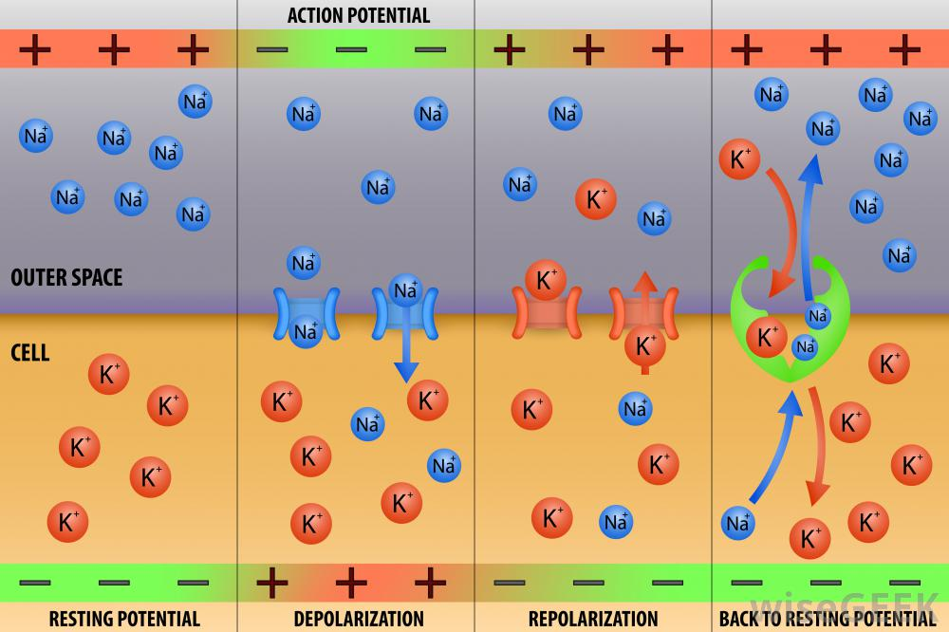

Slide 41
Coding for stimulus intensity
All APS are independent of stimulus strength and alike
So how does the nervous system know intensity?
Number of signals per second
Not by increasing amplitude or signal
Refractory period- neurons can only go so fast because the sodium channels have to reset to original resting state
This helps ensure all APS are separate and down the axon.
Relative refractory period- Normally nerves will not refire but CAN if the stimulus is strong enough.

Slide 42
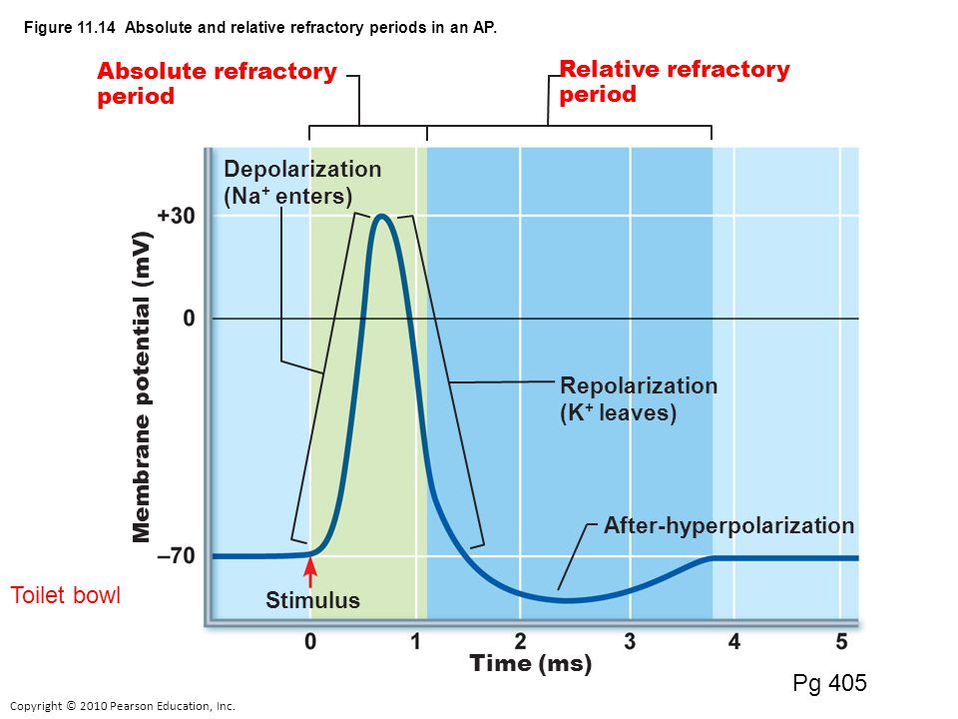

Slide 43
Speed of AP
The larger the diameter of axon = faster
Higher level of myelination = faster
Continuous propagation- nonmyelinated neurons = slower
Saltatory conduction- APS happen only at unmyelinated gaps in axon and signals jump from node to node
30x faster.

Slide 44
Local Anesthetics
Work by blocking voltage gated sodium channels
Why would this help?

Slide 45
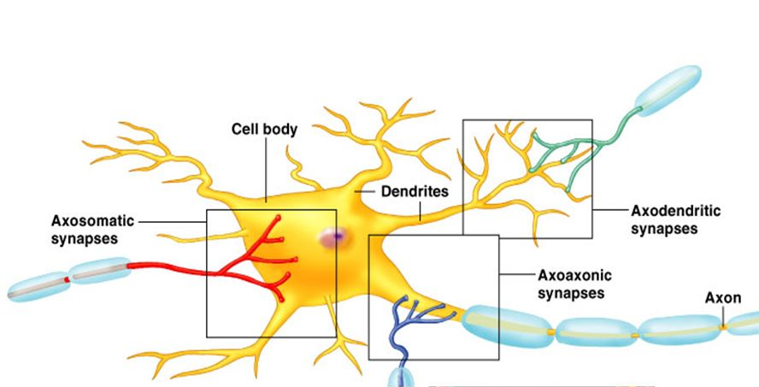
Passing on information
Happens at axon terminals
Done by neurotransmitters
Many types
Can be excitatory or inhibitory
Happens at the “Synapse”
Presynaptic neuron- original nerve transmitting signal
Postsynaptic neuron- new neuron

Slide 46
The Chemical Synapse
1. Action potential arrives at axon terminal or presynaptic neuron
2. Voltage gated calcium channels open
Calcium flows into neuron
3. Calcium influx causes release of vesicles of Neurotransmitters
Exocytosis
4. Calcium is quickly pumped back out of cell (active)
5. Neurotransmitter diffuses to postsynaptic neuron
6. Binding of NT opens ion channels
7. Neurotransmitter reabsorbed or destroyed

