Slide 1
The Digestive System

Slide 2
Digestive System
consists of:
Muscular, hollow tube (= “digestive tract”)
+
Various accessory organs

Slide 3
Function
Ingestion-taking food in
Mechanical digestion- preparing food for digestion. ^Surface area.
Segmentation- rhymic contractions of SI
Mixes food with digestive juices
Propulsion- involuntarily moving food
Peristalsis- waves of contraction to keep food moving
Chemical digestion- into building blocks
Absorption- dissolved food molecules into blood
Defecation

Slide 4
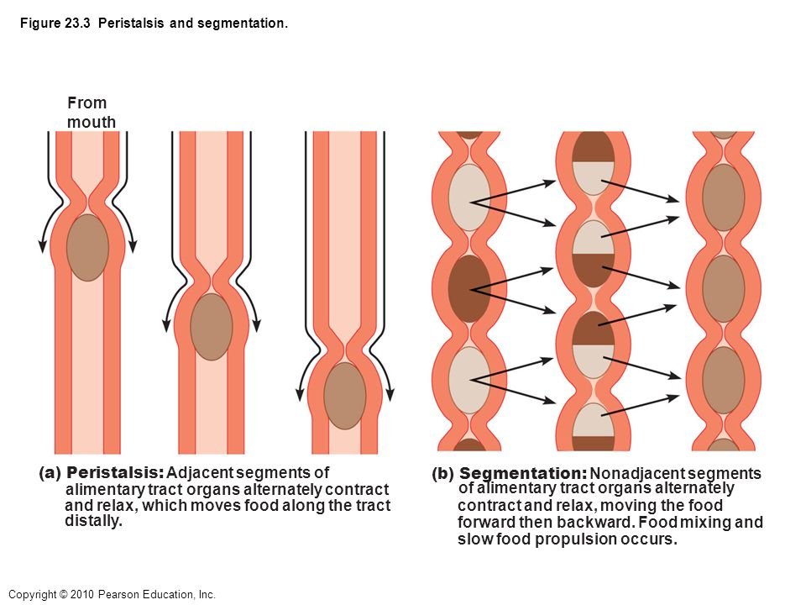

Slide 5
Overview of Digestive System
Alimentary canal- (GI tract)-continuous muscular tube from mouth to anus.
Digests
Absorbs
Mouth, pharynx, esophagus, stomach, SI, LI
Accessory Digestive organs
Teeth, pancreas, salivary glands, liver, tongue, gallbladder

Slide 6
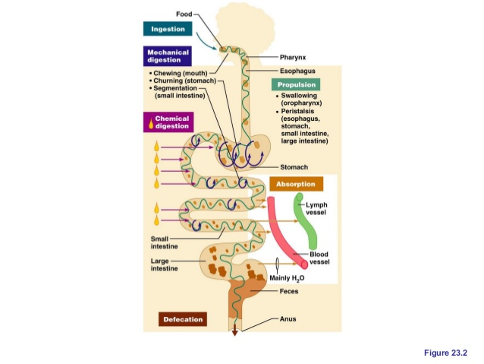

Slide 7
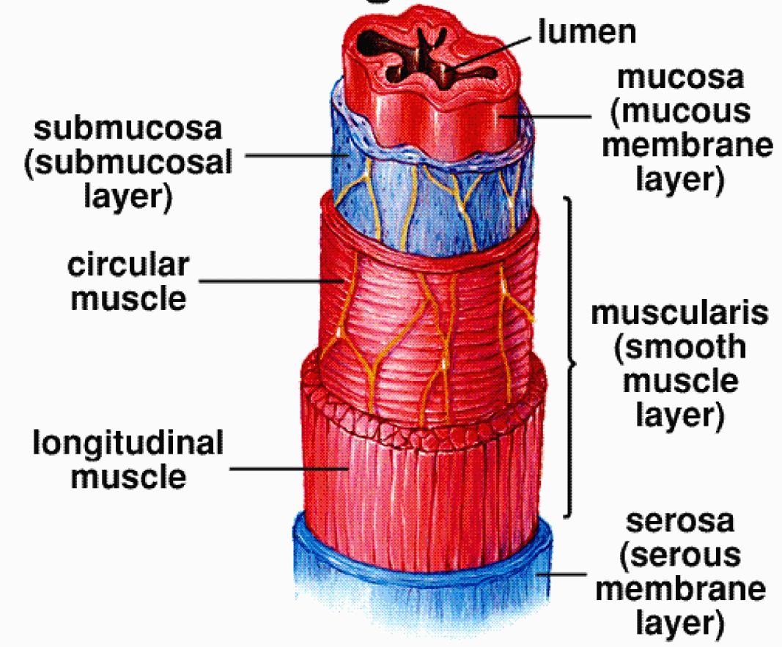
Histological Organization
Tube made up of four layers.
Modifications along its length as needed.
1
2
Muscularis
externa
3
4

Slide 8
The 4 Layers of the Gut
Fig 25.2
1) Mucosa
Epithelium – usually simple columnar with goblets; may be stratified squamous in mouth and esophagus
Lamina propria - connective tissue deep to epithelium
Muscularis mucosae -produces folds - plicae (small intestine) or rugae (stomach)
2) Submucosa – made up of loose connective tissue contains submucosal plexus and blood vessels
3) Muscularis externa – smooth muscle, usually two layers (controlled by the myenteric plexus ) -
outer layer: longitudinal
inner layer: circular
4) Serosa
visceral layer of mesentery or adventitia depending on location

Slide 9
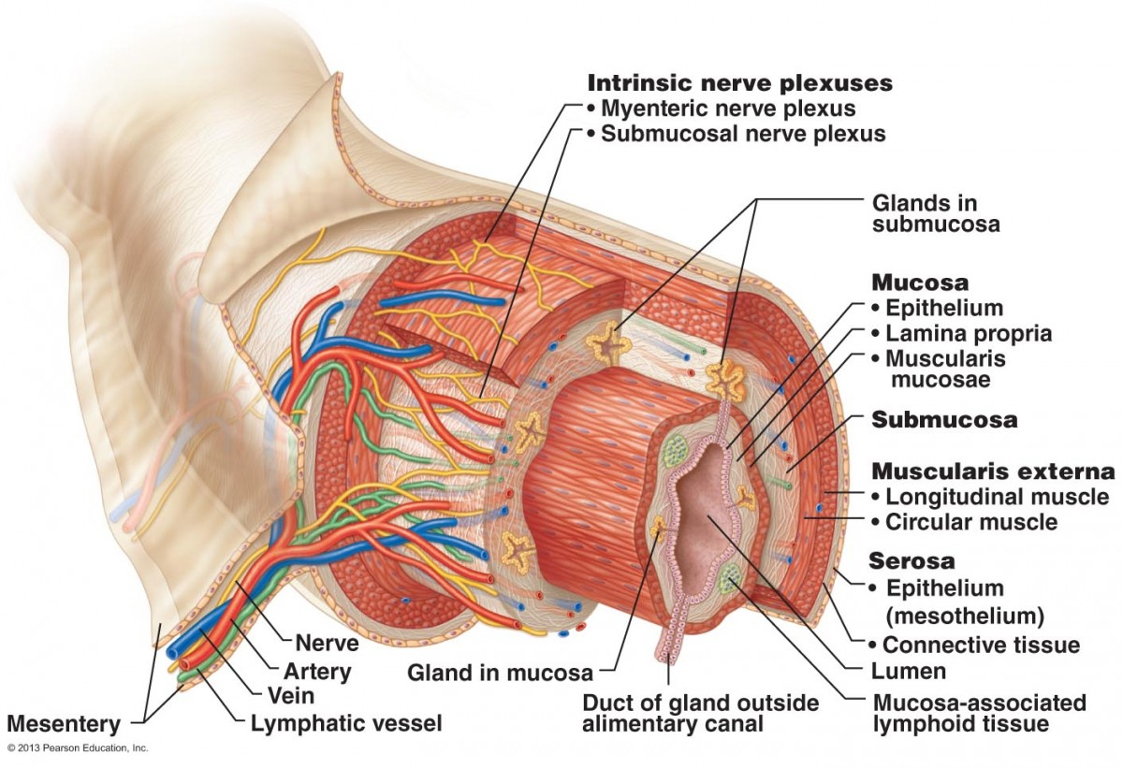

Slide 10
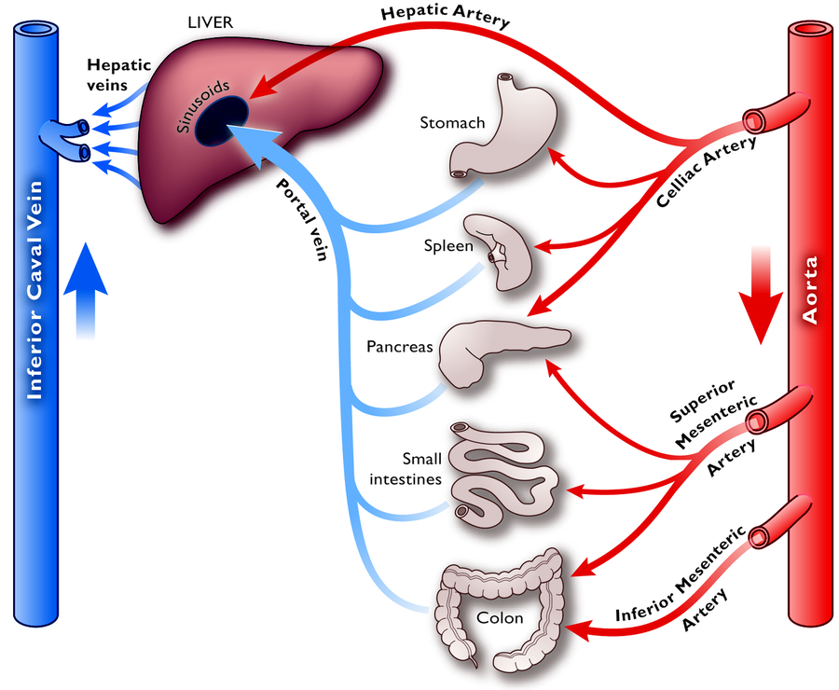
Blood supply to Gut
Splanchnic circulation- receives ¼ of cardiac output.

Slide 11
Membranes
Peritoneum - generic serous membrane in abdominal cavity
Mesenteries - double sheets of peritoneum, surrounding and suspending portions of the digestive organs
Greater omentum - "fatty apron", hangs anteriorly from stomach, double layer encloses fat
Lesser omentum - between stomach and liver
Mesentery proper - suspends and wraps the small intestine
Mesocolon - suspends and wraps the colon, parts are
Fig. 25.4

Slide 12
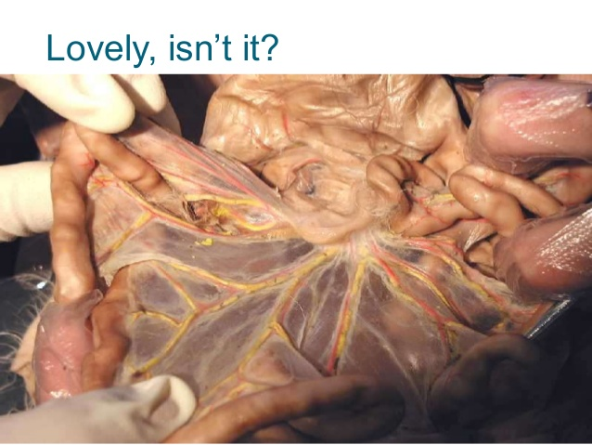
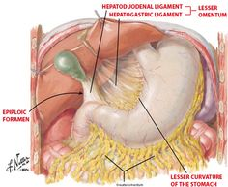
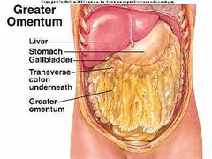

Slide 13
The Enteric Nervous System
Parasympathetic increases gut activity
Contains more neurons than the entire spinal cord.

Slide 14
The 2nd Brain?

Slide 15
Oral Cavity
Also called buccal cavity
Hard and soft palates - form roof of mouth
Tongue - skeletal muscle
Salivary glands - three pairs
Teeth

Slide 16
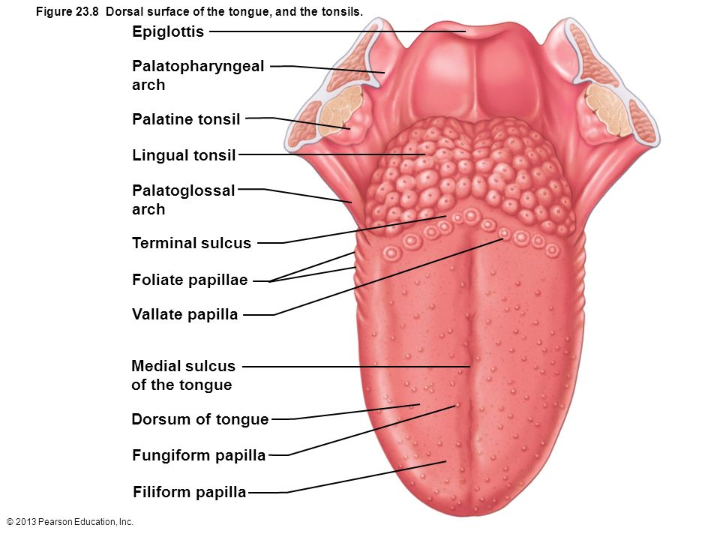
The Tongue
Mixes good with saliva to form bolus
Papillae- roughen the tongue surface
Filliform-MC

Slide 17
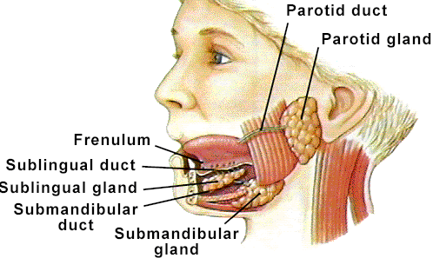
Three pairs of Salivary Glands
1-1.5 l / day for
digestion
lubrication (swallowing) moistening (tasting)
Parotid – lateral side of face, anterior to ear
Submandibular – medial surface of mandible
Sublingual – in floor of mouth

Slide 18
Mumps
Swollen, painful salivary glands on one or both sides of the face
Fever- About 1/3 of infected people do not show symptoms
Can lead to sterility
Effective vaccine since 1967

Slide 19
Structure of Teeth
Crown - exposed surface of tooth
Neck - boundary between root and crown
Enamel - outer surface, toughest substance in body
Root canal – nerve
Mastication- chewing
Deglutination- Swallowing
Involves 22 different muscle groups
Fig 25.7
Notes:
Enamel: Calcium phosphates. Hardest biological material produced.

Slide 20
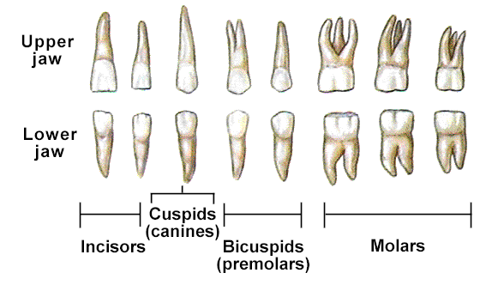
Types and Numbers of Teeth
Dental succession
Deciduous (baby, milk) teeth - 20, replaced by
Permanent teeth - 32 teeth

Slide 21
Teeth
Canines- Tearing
Molars- grinding
Dental cavities “caries” – bacterial action demineralizes enamel

Slide 22
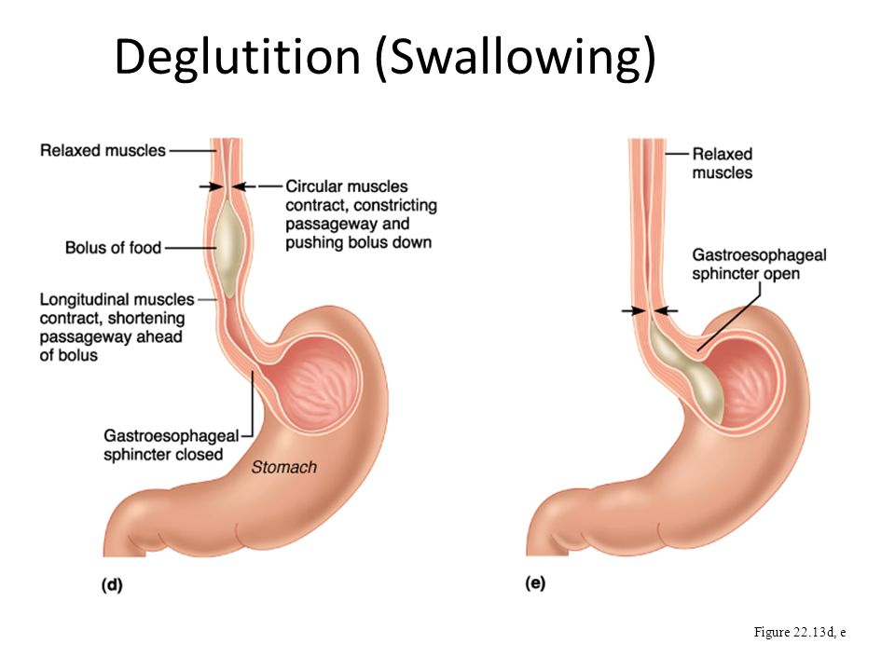
Esophagus
Muscular tube behind trachea.
Ends as the cardiac spincter

Slide 23
HEARTBURN
AKA: GERD
Symptoms can resemble heart attacks-
Pregnancy/ large meals and drinks / running can cause
Hiatal hernia- stomach protrudes above diaphragm. When laying down stomach acid leaks into esophagus

Slide 24
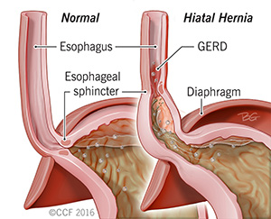

Slide 25
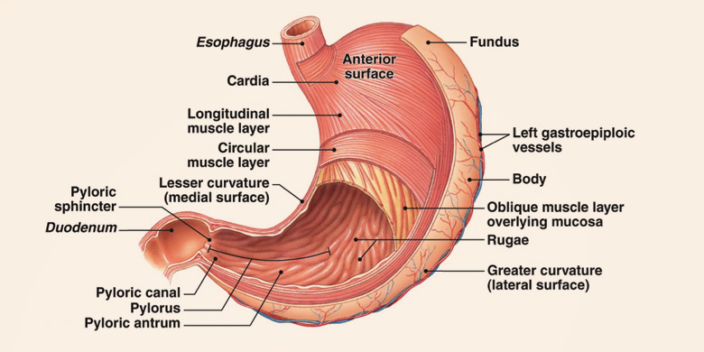
The Stomach

Slide 26
The stomach
“Storage tank” for food
Converts food into chime- creamy paste like

Slide 27
Gross Anatomy of the Stomach
Cardia - end under the heart
Fundus - bulge above the esophageal opening
Body - largest region
Pylorus - J curve, inferior end
Pyloric sphincters (importance?)
Rugae – highly extendable interior folds
Figs 25-10/11

Slide 28
Histology of Stomach
Fig 25.13
Type of epithelium lining stomach?
Gastric glands – deep in lamina propria
Parietal cells (produce HCl and intrinsic factor)
HCL activates pepsinogen by making it acidic (1.5-3.5)
IF- Helps with vitamin b12 absorption (need for RBC)
Chief cells (produce pepsinogen – inactive pepsin)
Begins protein digestion
Enteroendocrine cells – G cells (several hormones including gastrin which increases the action of the other 2)

Slide 29
Peptic Ulcers
Breach of protective mucous layer.
Causes gastritis – inflammation of stomach
Ulcers- erosions of stomach wall
Used to be blamed on excess HCL
Stess, spicy food, NSAIDS, alcohol, etc.
Now known that 90% are due to H. Pylori bacteria
Notes:
Breath test for h pylori

Slide 30
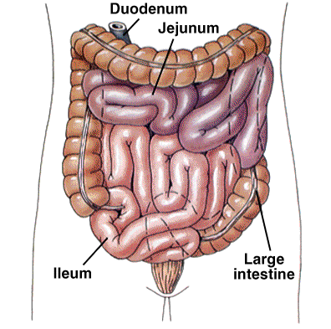
Regions of Small Intestine
SI is longest part of dig. tube
Duodenum (short, 12 inches)
fixed shape & position
Mixing bowl for chyme & ?
Jejunum (2.5 m long)
Most of digestion
Ileum (longest at 3.5 m)
Most of absorption, ends in
Ileocecal valve – slit valve into large intestine (colon)
Notes:
ENDS as the ileocecal valve where joins LI

Slide 31
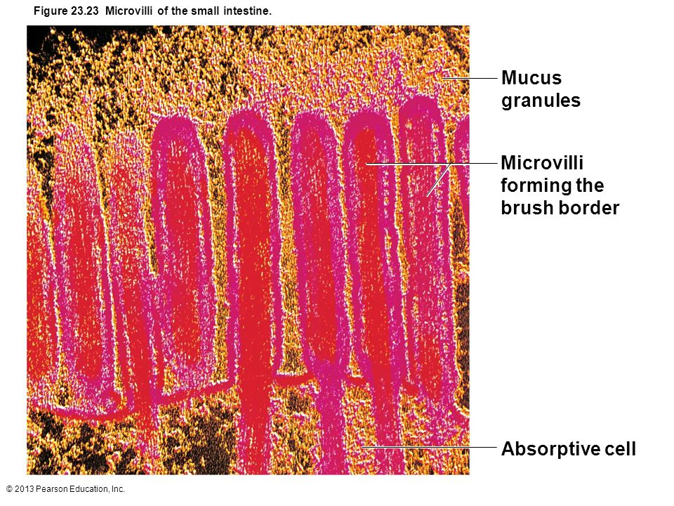
The Small Intestine
Huge surface area- Villi and microvilli- 200 sq meters (tennis court)
Chemo targets these rapidly dividing cells- nausea, diarrhea
Absorbs 95% H20

Slide 32
Regions of Large Intestine
Cecum – pocket at proximal end with Appendix
Colon
Ascending colon - on right, between cecum and right colic flexure
Transverse colon - horizontal portion
Descending colon - left side, between left colic flexure and
Sigmoid colon - S bend near terminal end
Fig 25-17
Rectum – terminal end is anal canal - ending at the anus - which has internal involuntary sphincter and external voluntary sphincter

Slide 33
5/9
List the parts of the small and large intestine in order.
What do the 3 stomach cells that we talked about yesterday do?

Slide 34
Accessory Organs of SI
Liver- Produces bile to duodenum
Breaks down fats
Largest gland in body
Also plays a huge role in detoxifying blood
Gallbladder- bile storage

Slide 35
Pancreas
Releases enzymes to help with breakdown of all foods
Amylase- Starch
Lipase-Fats
Nuclease- DNA
Proteases- Proteins

Slide 36
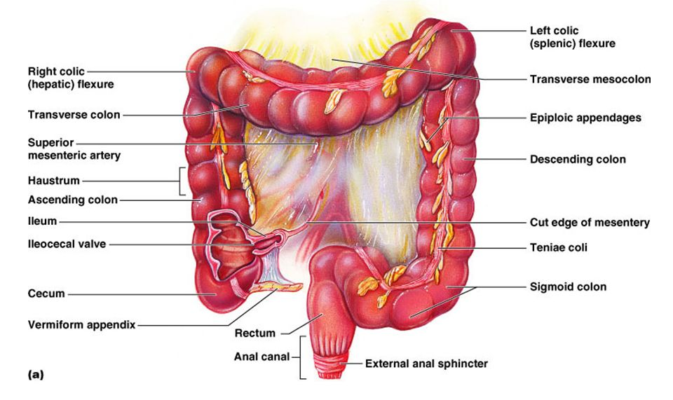
Large Intestine
Water absorption
Elimination of remaining feces
Appendix

Slide 37
Histology of Large Intestine
1. Mucosa - abundant goblet cells, stratified squamous epithelium near anal canal
2. No villi
3. Longitudinal muscle layer incomplete, forms three bands or taenia coli
4. Circular muscle - forms pockets or haustra between bands
Fig 25.19

Slide 38
Large Intestine Flora
10 million different types!
Make B vitamins and Vitamin K
Help breakdown cellulose and other compounds
Fermentation produces gases

Slide 39
Digestion-Carbs
Sucrose (table sugar)
Lactose (milk sugar)
Maltose (grain sugar)
Glycogen – Animal storage
Starch – Plant storage
Indigestible polysaccharides (cellulose)
Salivary Amylase- mouth saliva
Pancreatic Amylase- Small intestine
Break down into “oligosaccharides”
Microvilli digestive enzymes for disaccharides (SI)

Slide 40
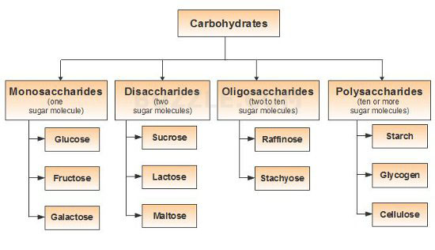

Slide 41
Digestion- Lipids
Triglyceride- Most common type
Lipases break it down
Gastric lipase
Pancreatic lipase (SI)
Leaves free fatty acids and glycerol
Bile helps carry fatty acids across the intestinal mucosa- emulsification

Slide 42
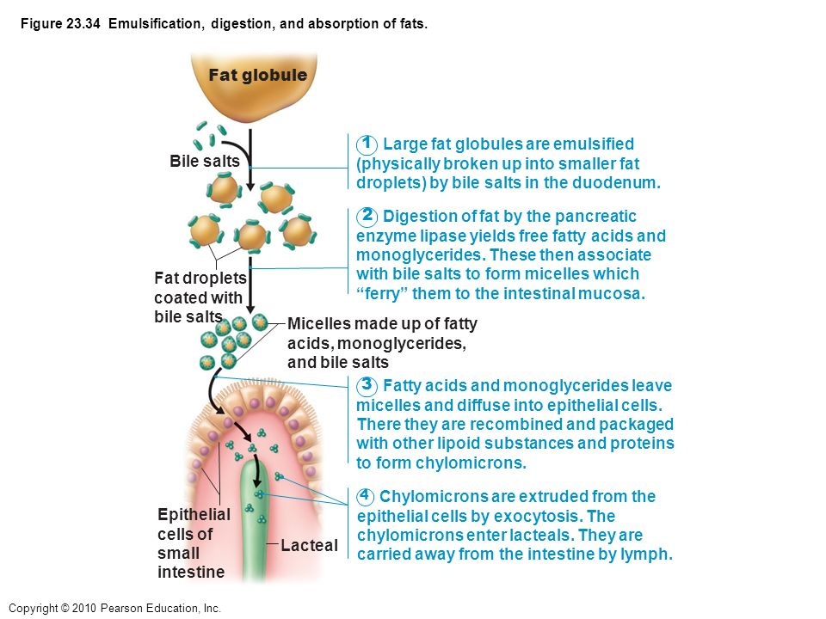

Slide 43
Protein Digestion
Pepsin- stomach (chief cells)- inactivated by higher ph of duodenum.
15%
Typsin and chymotrypsin-pancreas
Break proteins into smaller chains
Carboxypeptidase and aminopeptidase finish breakdown in SI to Amino Acids

Slide 44
Water Absorption
95% is absorbed by the Small intestine by osmosis
The rest is absorbed by the large intestine
.1 L is left to help soften stool

Slide 45
5/10

Slide 46
Hepatitis
Inflammation of liver
Often due to viral disease- 5 types (A-F)
B sexual contact or blood – chronic
40%- increased risk of liver cancer too
Vaccine against
A-32% infectious hepatitis- sewage contaminated food
C- Chronic liver infections/new treatments

Slide 47
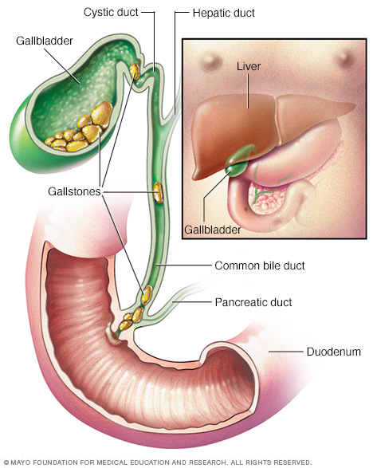
Gallstones
Bile helps excrete cholesterol from body.
Too much causes it to crystallize into sharp crystals
Sx:pain in upper back and right shoulder/side
Nausea / vomiting
Juandice
Notes:
Older females/ pregnant / oral contraceptives

Slide 48
Chrohn’s Disease
Type of IBD-inflammation of lining of intestine, can affect SI and LI
Severe diarrhea, weight loss, malnutrition
Probably autoimmune disease

Slide 49
Ulcerative Colitis
Another IBD
Long lasting ulcers in digestive tract in Large intestine
Bloody diarrhea, Cramps, weight loss
Comes and goes

Slide 50
Inguinal Hernias
70% of all hernias
Intestine pushes through a weak spot in the abdominal wall
Pain on coughing, bending, lifting

Slide 51
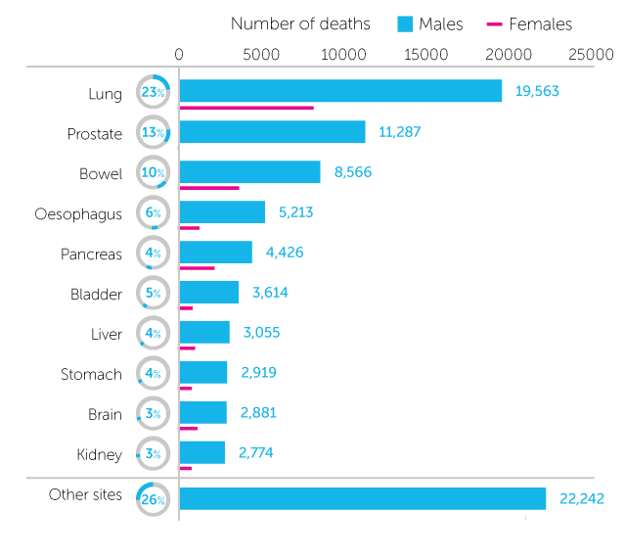
Colon Cancer

Slide 52
Colon Cancer
Risks: Smoking, physical inactivity, obesity, age, genetic
Diet high in red meats / Processed meats/ frying and grilling foods
Sx: Blood in stool/ persistent abdominal cramping or gas / unexplained weight loss/ change in bowel habits for longer than 4 weeks

Slide 53
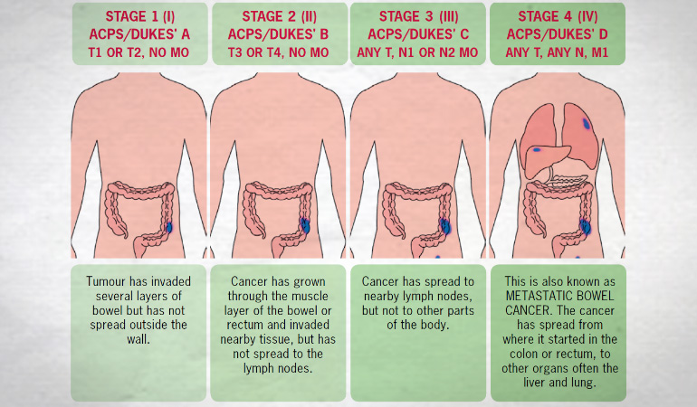
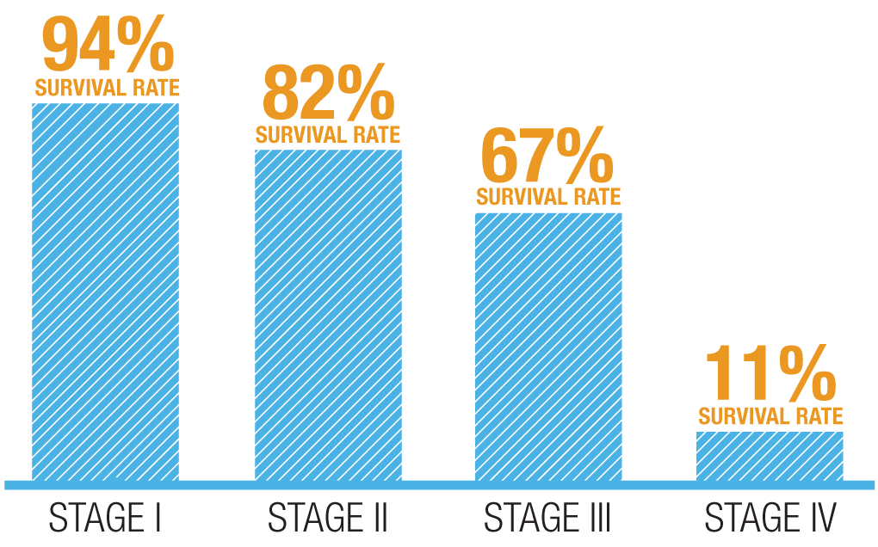
Colon Cancer

Slide 54
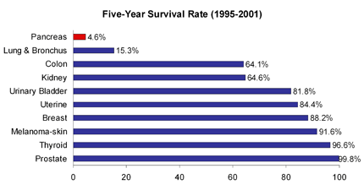
Pancreatic Cancer

Slide 55
Pancreatic Cancer
Sx:Pain in abdomen and back / jaundice (late term) / vomiting/ early feeling of fullness/ pale colored stool/ weight loss

Slide 56
The End

