Slide 1
Types of Connective Tissue
Connective Tissue Proper:
Loose Connective Tissue- supports structures that it surrounds
Areolar, Adipose, Reticular
Dense Connective Tissue- highly fibrous (collagen); little vascularization ground substance, or cells; reinforces and binds structures
Dense regular, Dense irregular, Elastic
Specialized Connective Tissue:
Cartilage
Hyaline, Elastic, Fibrocartilage
Bone
Compact, Cancellous
Blood

Slide 2
Loose Connective Tissue: Areolar
Most common type of connective tissue
Surrounds every organ, connects skin to muscle, envelops blood vessels, nerves, and lymph nodes
Acts to support and cushion organs and other delicate structures.
Predominant cell is fibroblast
Flexible, moderately elastic, but tears easily compared to other connective tissue.
Has “open” spaces that are filled with fluid and viscous ground substance
GS- Hyaluronic acid
Nutrients and wastes easily move in and out of bloodstream; foreign invaders get trapped
Hyaluronidase allows WBCs to pass through easily
Filling of open spaces during trauma is called edema

Slide 3
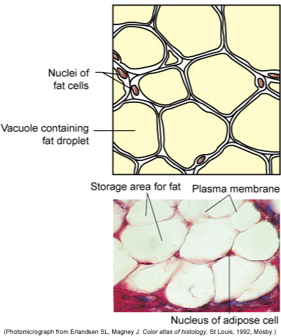
Loose Connective Tissue: Adipose
Found beneath skin, between muscles, behind eyeballs, on heart surface, around joints, in bone marrow, in abdomen
Energy storage, insulator, shock absorber
Highly vascularized areolar tissue in which adipocytes predominate
Cells expand/shrivel based on amount of lipid being stored in them.
May be classified as:
White:
Found throughout body
Adipocytes change from resembling fibroblasts to filling with lipid, which swells the cell and pushes the organelles and nucleus to the side and compresses the cytosol to a rim
Brown:
Found in newborns and hibernating animals
Site of heat production, temperature regulation

Slide 4
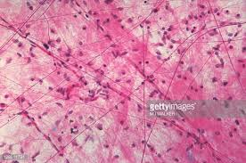

Slide 5
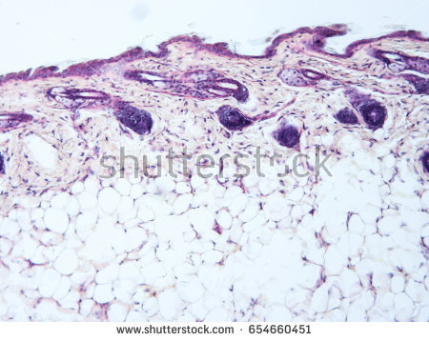

Slide 6
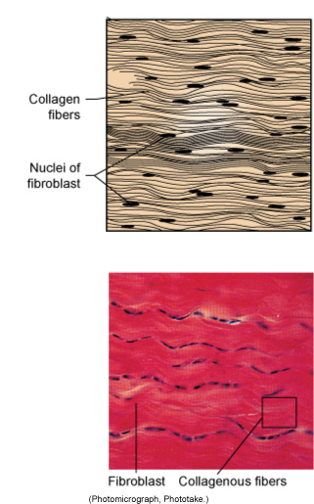
Dense Connective Tissue: Regular
Makes up tendons and ligaments, fascia
Tightly packed, parallel collagen fibers
Little vascularization, slow to heal
Little ground substance
Fibroblasts line the collagen bundles
Resists strong pulling forces in one direction.

Slide 7
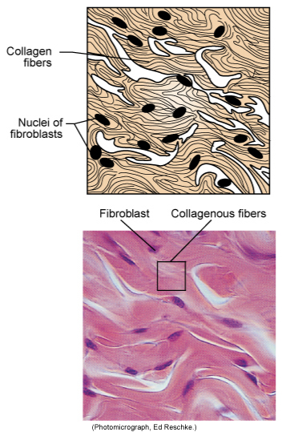
Dense Connective Tissue: Irregular
Found in dermis, organ capsules
Forms tough capsule of joints.
Collagen fibers in thicker bundles than those in dense regular connective tissue.
Sheets of collagen run or stacked in different directions.
Single sheet that can withstand force from many different directions.

Slide 8
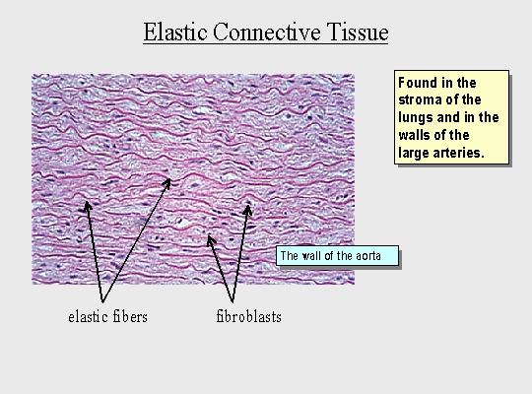
Elastic Connective Tissue
Found in areas of the body that require stretching:
Stomach, large airways, artery walls, bladder, between vertebrae
Beneath transitional epithelium in urinary tract
High concentration of elastic fibers (more than collagen) that is extremely flexible.

Slide 9
Specialized Connective Tissue: Cartilage
Tough, specialized connective tissue.
May be called gristle.
More rigid than dense connective tissue, more flexible than bone.
Prevents bones from rubbing against each other
Does not contain nerves or blood vessels.
Cells are chondrocytes
Fluid gives nutrients to the chondrocytes, which live in pockets called lacunae
Fluid allows cartilage to be resilient and withstand compression
3 types of cartilage:
Hyaline cartilage, Elastic Cartilage, Fibrocartilage

Slide 10
Specialized Connective Tissue: Types of Cartilage
Hyaline Cartilage
Most common type of cartilage found in body.
Found as articular cartilage at end of long bones and joints and connects ribs to the sternum.
Nose, trachea, larynx
Most rigid type of cartilage.
Closely packed collagen fibers that make it tough but more flexible than bone.
Elastic Cartilage
Similar to hyaline cartilage but contains elastic fibers
Give it flexibility, ability to bend
Found in pinnae, ear canal, epiglottis

Slide 11
Specialized Connective Tissue: Types of Cartilage
Fibrocartilage
Found between vertebrae, in pelvis, and in knee joint
Thick bundles of collagen, but few chondrocytes
Thicker bundles than hyaline, matrix less firm

Slide 12
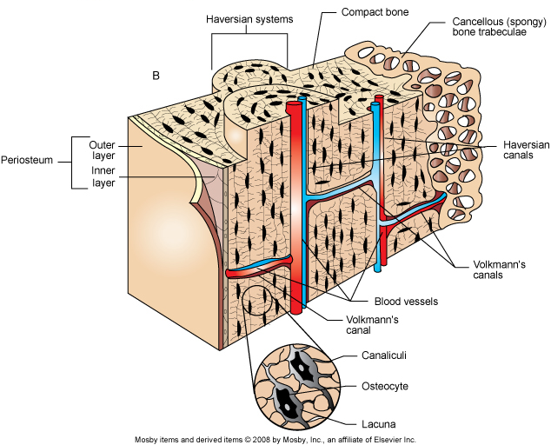
Specialized Connective Tissue: Bone
Also called osseous connective tissue
Hardest and most rigid type of connective tissue
Forms animal’s frame, protects organs, calcium reserve, fat storage, blood cell production
Is well vascularized
Structure
Matrix – collagen fibers and calcium salts
Canaliculi- tiny channels through matrix that allows osteocytes to communicate
Lacunae- chambers where osteocytes reside
Blood Supply- Haversian canals (channels in bone that carry blood supply and nerves)
Cells- Osteoclasts and osteoblasts
Remodel bone as needed

Slide 13
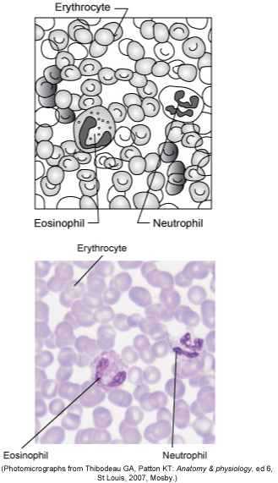
Specialized Connective Tissue: Blood
Most atypical type of connective tissue.
Carries nutrients and gases through the body
Matrix: liquid (plasma)
Fibers: few and only visible in a clot
Cells:
Erythrocytes (red blood cells)
Leukocytes (white blood cells)
Thrombocytes (platelets)

Slide 14
Membranes
Thin, protective layers that line body cavities, separate organs and cover surfaces.
Epithelial sheet bound to underlying layer of connective tissue proper.
Epithelium is usually bathed in liquid
Four common epithelial membranes are:
Mucous
Serous
Cutaneous
Synovial

Slide 15
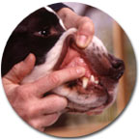
Mucous Membranes (mucosa)
Always found lining organs that have connection to outside environment.
Digestive, respiratory, urinary, and reproductive tracts
Epithelium: stratified squamous, simple columnar, transitional
Covers the lamina propria (areolar connective tissue)
Secretion: Produces mucus (exception: urinary tract)
lubrication, defense, reduce friction
Play role in monitoring and controlling what enters into body.
Absorption: microvilli in digestive system

Slide 16
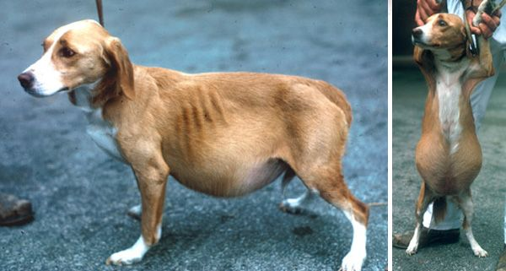
Serous Membranes (serosa)
Line walls and cover organs that fill closed body cavities
(organs in chest and abdomen)
Continuous membrane sheet that is doubled over to form a parietal and visceral layer.
simple squamous epithelium + loose connective tissue
Fluid is found between the two serosal layers to reduce friction.
pleural, peritoneal, pericardial fluid
Large amount of fluid is called effusion.
Effusion in abdomen is termed ascites.
Adhesions are connections between parietal and visceral layers that form when the serous membranes are damaged.

Slide 17
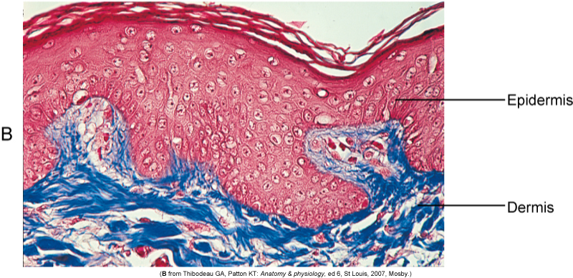
Cutaneous Membranes (integument/skin)
Perpetually exposed to environment.
Composed of keratinized stratified squamous epithelium called epidermis
Epidermis is attached to underlying dense irregular connective tissue called dermis.

Slide 18
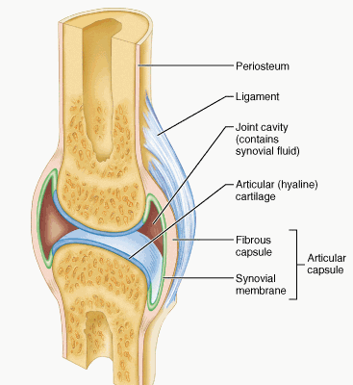
Synovial Membranes
Line the cavities of joints
Contain no epithelium
composed exclusively of loose adipose connective tissue covered by collagen and fibroblasts
Manufacture synovial fluid that fills the joint spaces and reduces friction and abrasion at the ends of bones.

