Slide 1
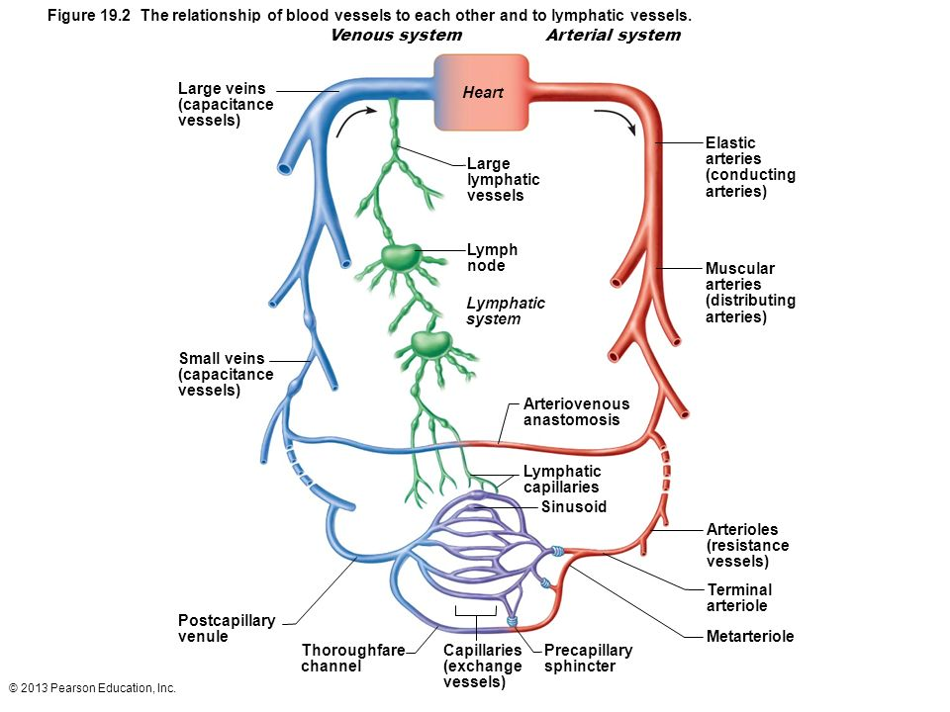
Types of Blood Vessels

Slide 2
Layers of blood vessels
Tunica intima- inner
Contains endothelium- simple squamous lining
Tunica media- smooth muscle and elastin
Regulated by sympathetic nervous system
Often thickest layer
Tunica Externa- collagen layer with nerves and lymph vessels
Vasa vasorum – tiny blood vessels for large blood vessels

Slide 3
Arteries
Elastic- Thick walled near the heart (aorta and major branches)
AKA Conducting arteries
Allow blood flow here to be continuous
Muscular- Deliver blood to organs
AKA Distributing arteries
Most of the named arteries
Thickest tunica media
Do vasoconstriction
Arterioles- Determine blood flow to capillaries.

Slide 4
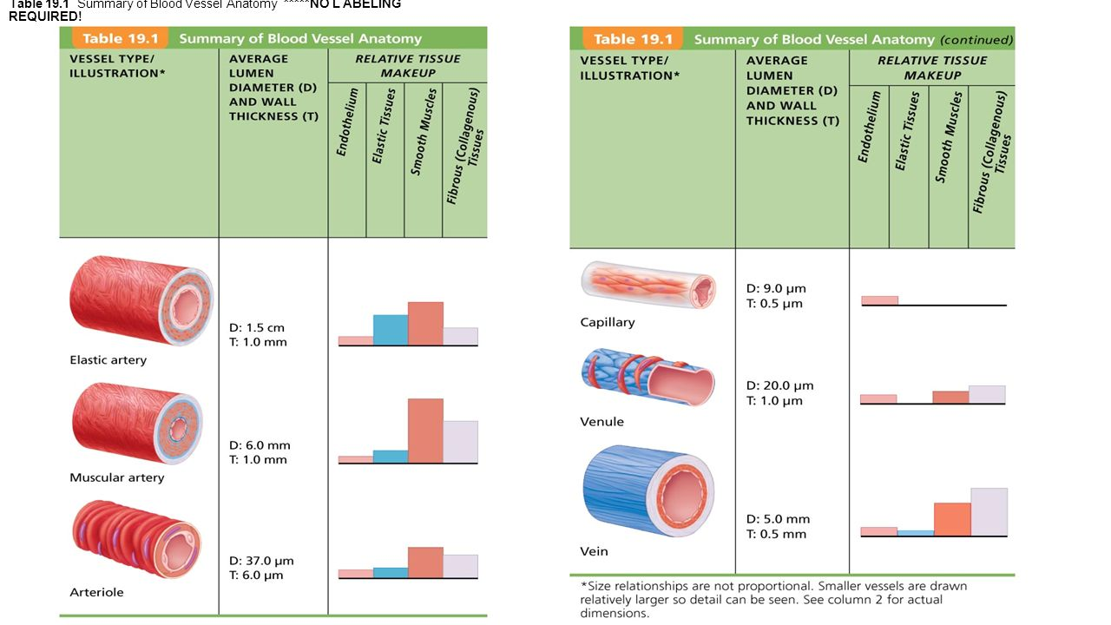
Blood vessel types

Slide 5
Capillaries
Microscopic, consist of just a thin layer of endothelium.
Form capillary beds- interwoven networks of capillaries

Slide 6
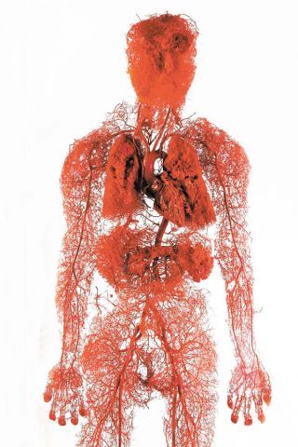

Slide 7
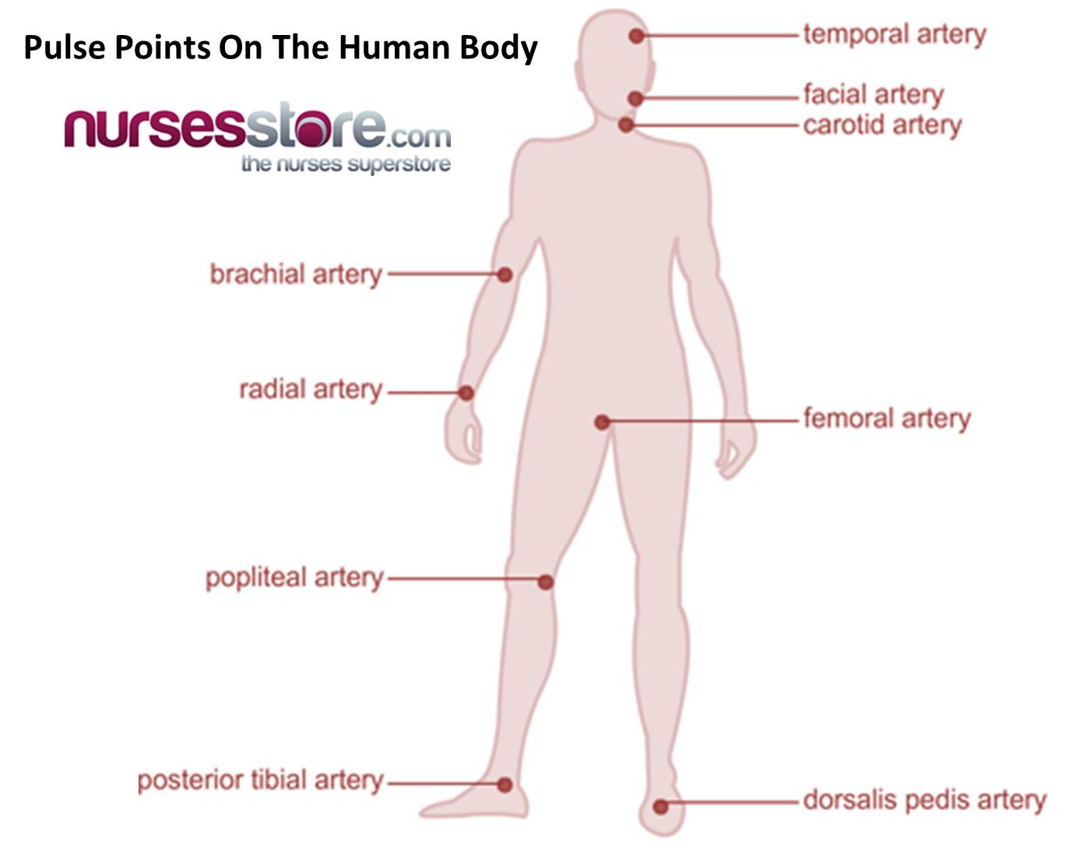

Slide 8
Venous System
Carry blood from capillaries to the heart
Get progressively larger
Venules
Veins
Veins
Have all 3 layers, but thinner than arteries
Very little smooth muscle
Mostly tunica externa
Blood reservoirs- can hold up to 65% of bodies blood
Venous system much more interconnected than arteries
Veins are more superficial than arteries
Valves- Mostly in limbs
Demonstrate
Notes:
Valve demonstration- two fingers move one probimal and it stays flat until release other.

Slide 9
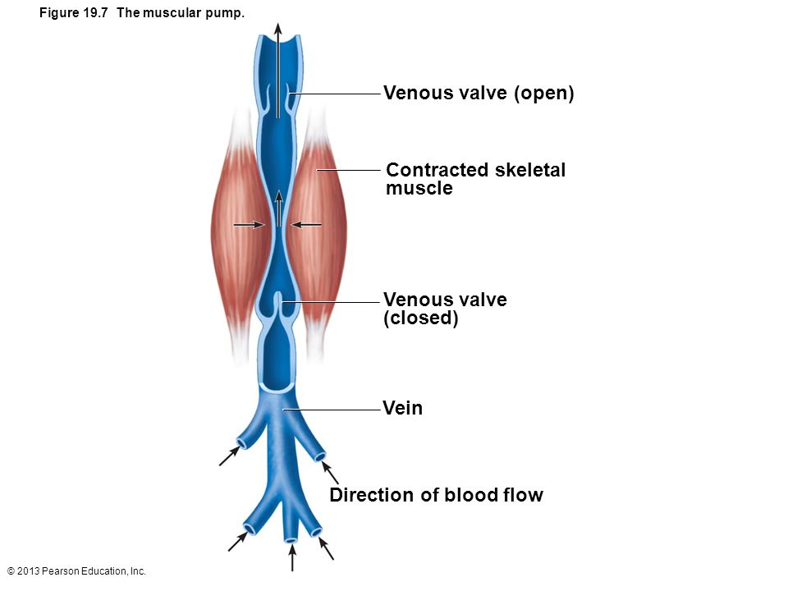
Notes:
Standing for long periods can cause blood to pool in feet. Respiratory pump too, changes pressures as breath forces blood toward heart allowing veins to expand

Slide 10
Heart Sounds

Slide 11
Heart Problems
Arrhythmias- uncoordinated atrium and ventricles
Defibrillation – electrically shocking heart to depolarize whole heart and hope SA node takes back over.
Heart Murmur- Often due to acquired valve defects.
Valve Stenosis- narrow valves, hard to get blood through.
Valve regurgitation- hard to completely close.
Endocarditis, valve calcification, and rheumatic fever
Valve prolapse- valve is weak and is pushed in the atrium during contraction

Slide 12
Heart Sounds
https://www.youtube.com/watch?v=42IahK-zxj0&list=PLsv-mwq3f7zbVGJCD7UixV6t4ieEOMtBr

Slide 13
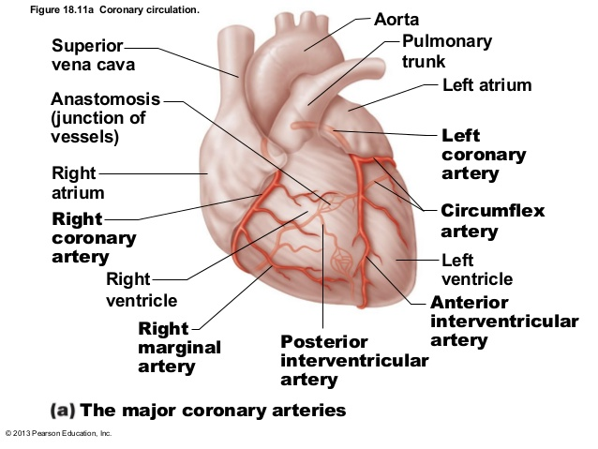
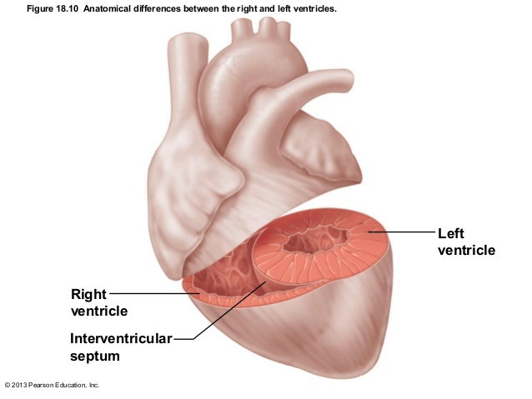
Coronary Arteries

Slide 14
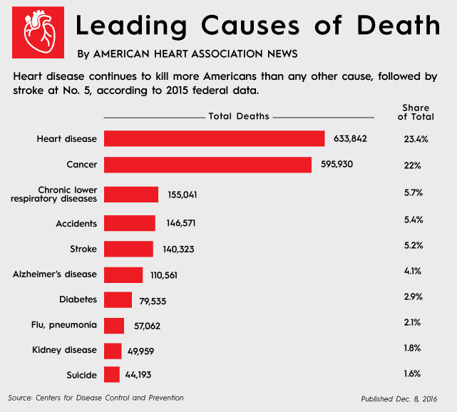
Heart Attack (MI)
Part of the heart does not receive enough blood flow.
1 of 5 is “silent”
Most common cause is coronary artery plaque

Slide 15
11/10
What are the 3 layers of an artery?
Which is thickest in muscular artery?
Which is the only one in a capillary?
Which do veins have?
What is different between veins and arteries
What is Mitral Valve Regurgitation?
Objective:

Slide 16
Myocardial infarction

Slide 17
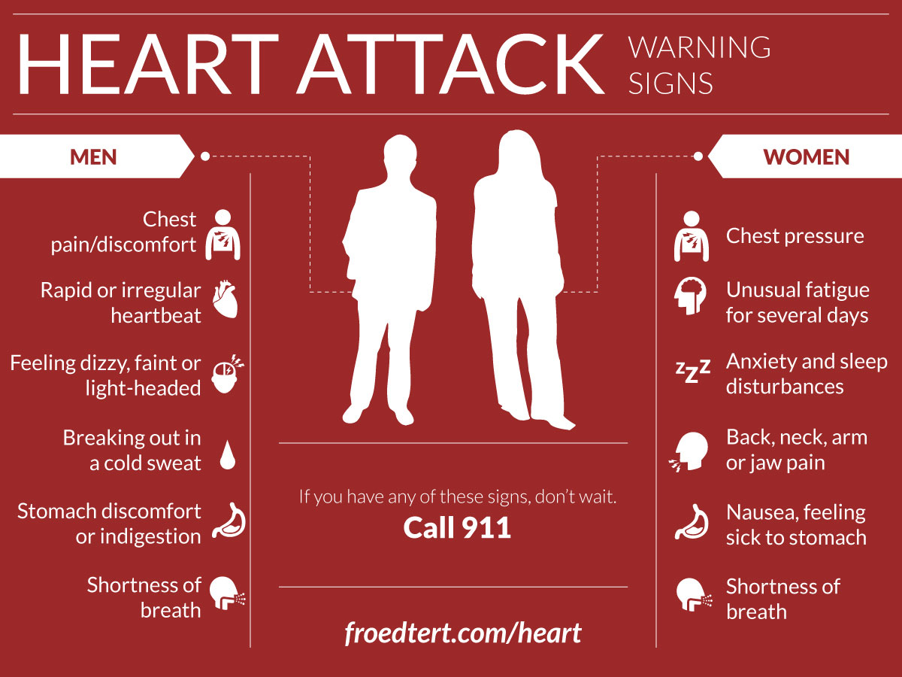
Heart Problems
Angina Pectoralis

Slide 19
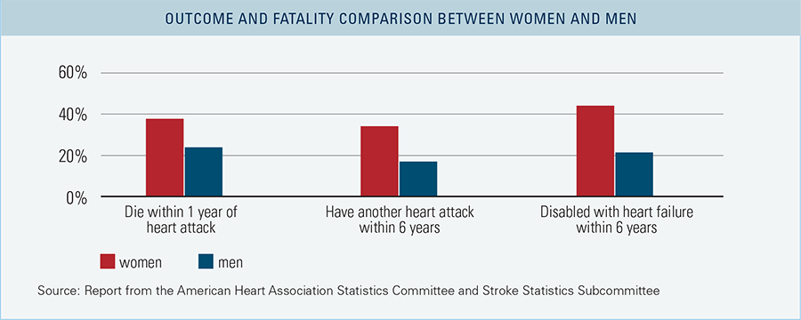

Slide 20
Cardiac Cycle
Systole-period of contraction of the ventricles
Diastole- period of relaxation (filling)
Tachycardia-resting heart rate over 100
Stress, elevated body temperature, drugs, and disease can cause it
Promotes fibrillation
Bradycardia- under 60

Slide 21
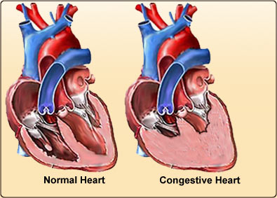
Congestive Heart Failure
Progressive inability of heart to pump blood efficiently
Persistent High Blood pressure is the main cause
Heart must exert more force to open aortic valve
MI can cause
Atherosclerosis of coronary arteries
Left sided most common

Slide 22
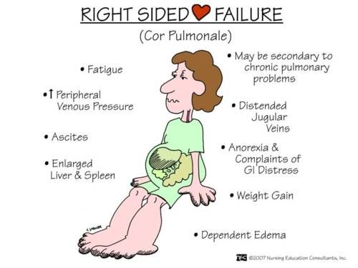

Slide 23
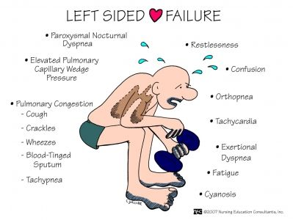

Slide 24
Stroke
Blood supply to portion of brain impacted
Brain cells begin dying within minutes
85% due to thrombus or embolus
15% Hemorrhagic - blood vessel burst
Transient Ischemic attack- (TIA) temporary decrease of blood flow to area of brain
Still should seek care , high risk of future stroke
Risks: BP, obesity, Older men, Family history, heart disease, diabetes, cigarettes.

Slide 25
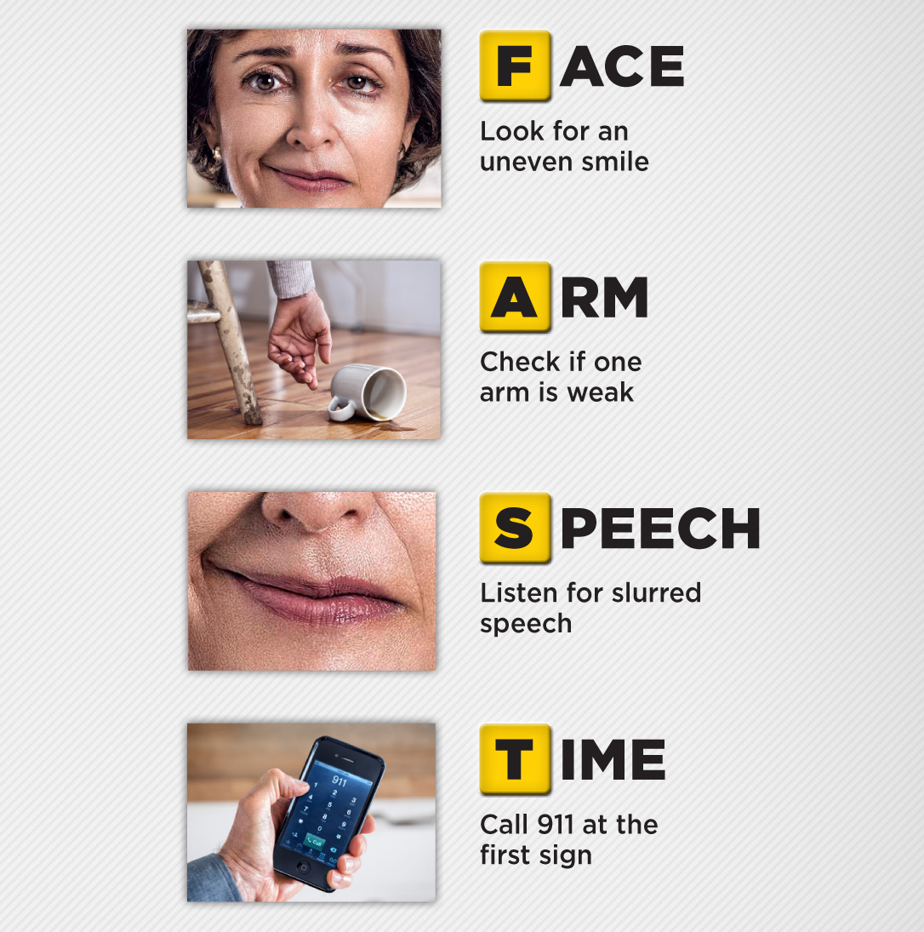
Stroke

Slide 26
WBC diseases
Leukemia- Group of cancers of WBCs
Usually affect only one cell type
Causes a flood of immature WBCs
Nonfunctional
Sx: fever(night sweats), weight loss, bone pain, prolonged fatigue
Die from internal hemorrhage and infection

Slide 27
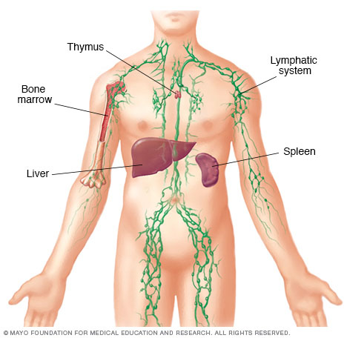
Lymphatic System

Slide 28
Lymphatic System
2 functionally different but structurally overlapping systems
Lymphatic system- network of vessels, lymph, and nodes.
Lymphoid organs and tissue- structural basis of the immune system
Spleen, thymus, tonsils, nodes, other tissues.

Slide 29
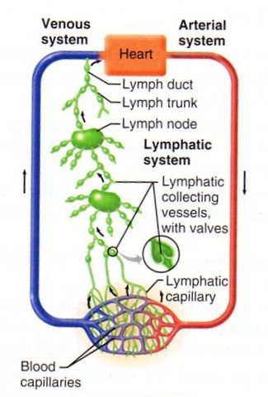
Lymphatic System
Collect leaked fluid from capillaries
Return it to blood to ensure volume
Also return proteins from blood
“Interstitial fluid”
Have valves like veins
No pumping system- rely on nearby muscles to milk it back to heart or nearby arteries.
Lymphedema- anything that blocks the normal flow causes buildup of fluid.
Can eventually regrow vessels around obstruction

Slide 30
Lymph Organs- nodes
Cluster in inguinal, axillary, cervical regions
Places where vessels converge to form ducts
Functions:
Filtration- macrophages remove debris and microorganisms.
Immune System activation
Cancerous- swollen and non-tender, stuck to tissue
Infection- swollen and tender, moveable

Slide 31
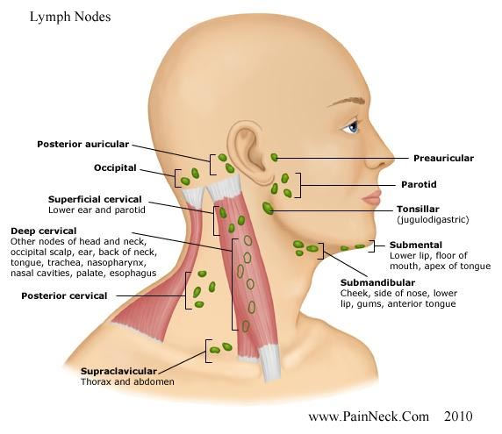

Slide 32
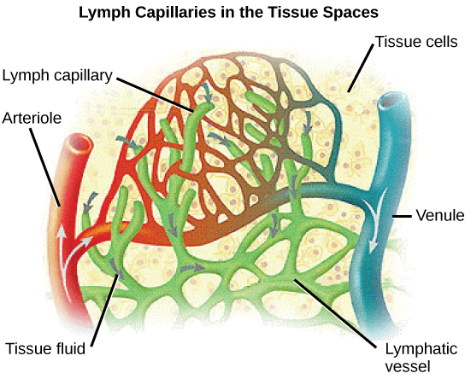

Slide 33
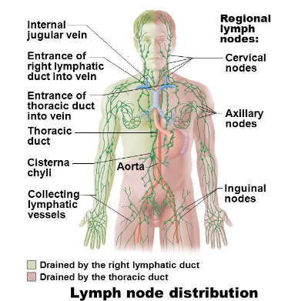

Slide 34
Spleen
Size of fist, located just beneath diaphragm (left)
Functions
Blood cleaning- moves defective and old cells.
Stores material from RBC breakdown- iron
Stores platelets and monocytes for release when needed
Can rupture
Used to be removed, but now they try to let it repair itself.
Liver and bone marrow will take over most of its function if removed.

Slide 35
4/27
Describe the steps of decreasing blood pressure in response to elevated blood pressure.

Slide 36
Thymus
Anterior to the neck
Produces T lymphocytes
Most important in younger. Completely atrophies in older age.

Slide 37
Mucosa-associated Lymphoid Tissue (MALT)
Help protect against never ending pathogens that try to enter body.
Tonsils- Entrance to throat
Remove particles in air and food
Trap bacteria and allow local infection so that they can develop a ‘memory’ for later years
Why at risk for infection early on
Peyer’s Patches- like tonsils but on distal small intestine.
Appendix- Off of Large Intestine

