Slide 1
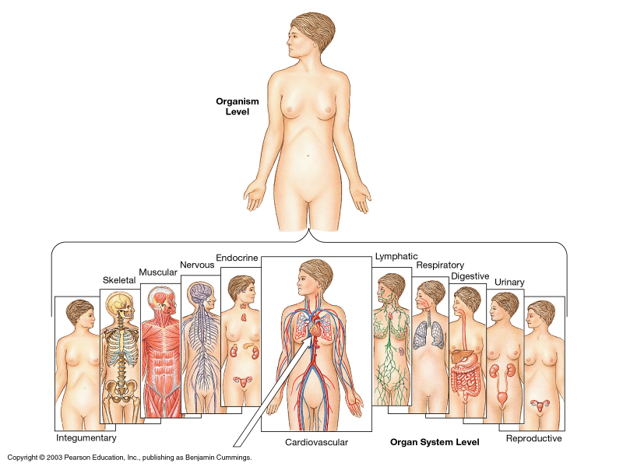
Organ Systems

Slide 2
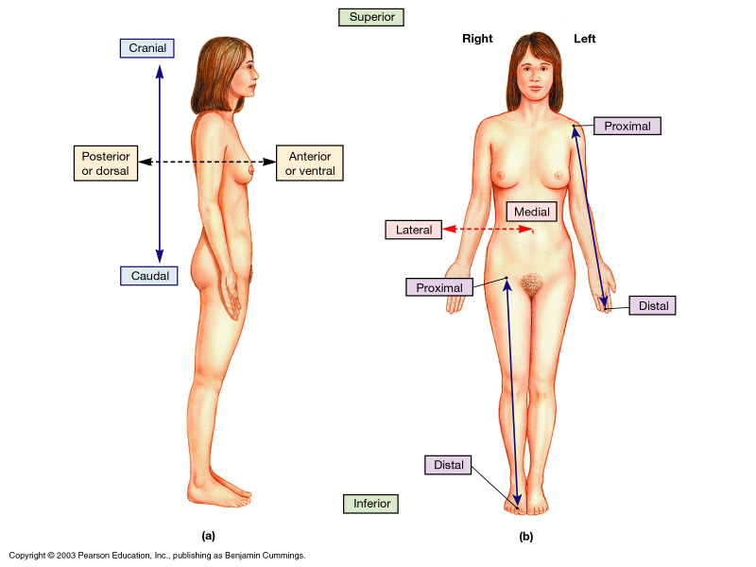

Slide 3
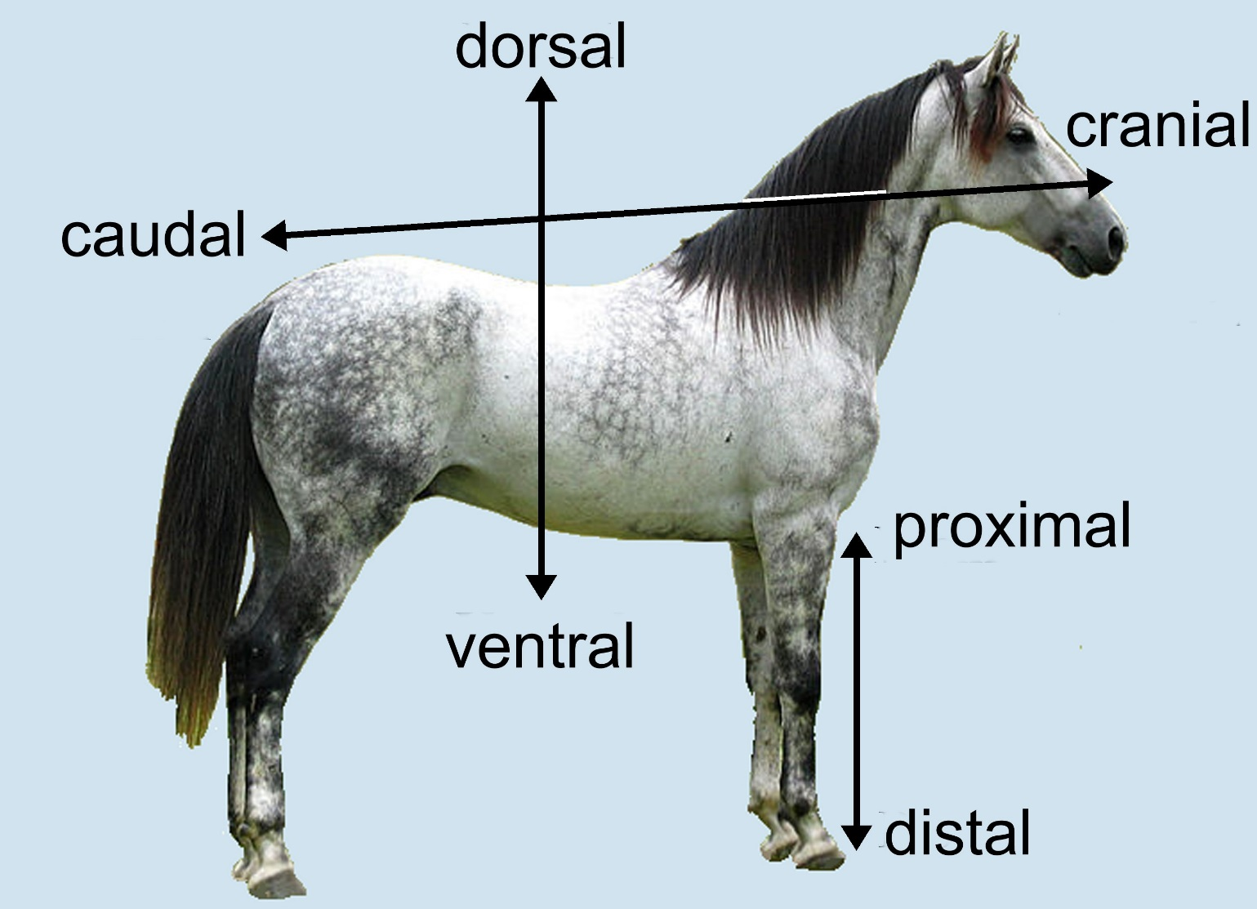
Four-footed body directions

Slide 4
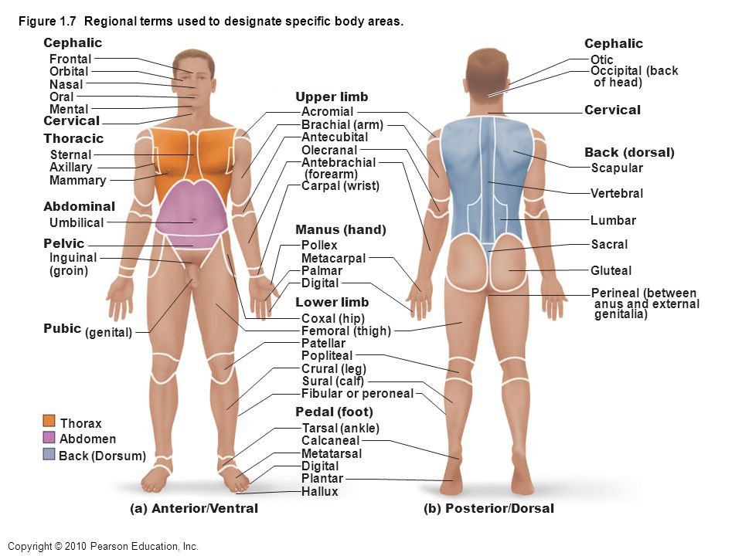

Slide 5
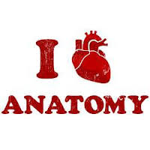
Human Anatomy: An introduction

Slide 6
What exactly is Anatomy and Physiology anyway?
Ana – apart tomy – to cut
Physio – body logy- study of
STRUCTURE = FUNCTION

Slide 7
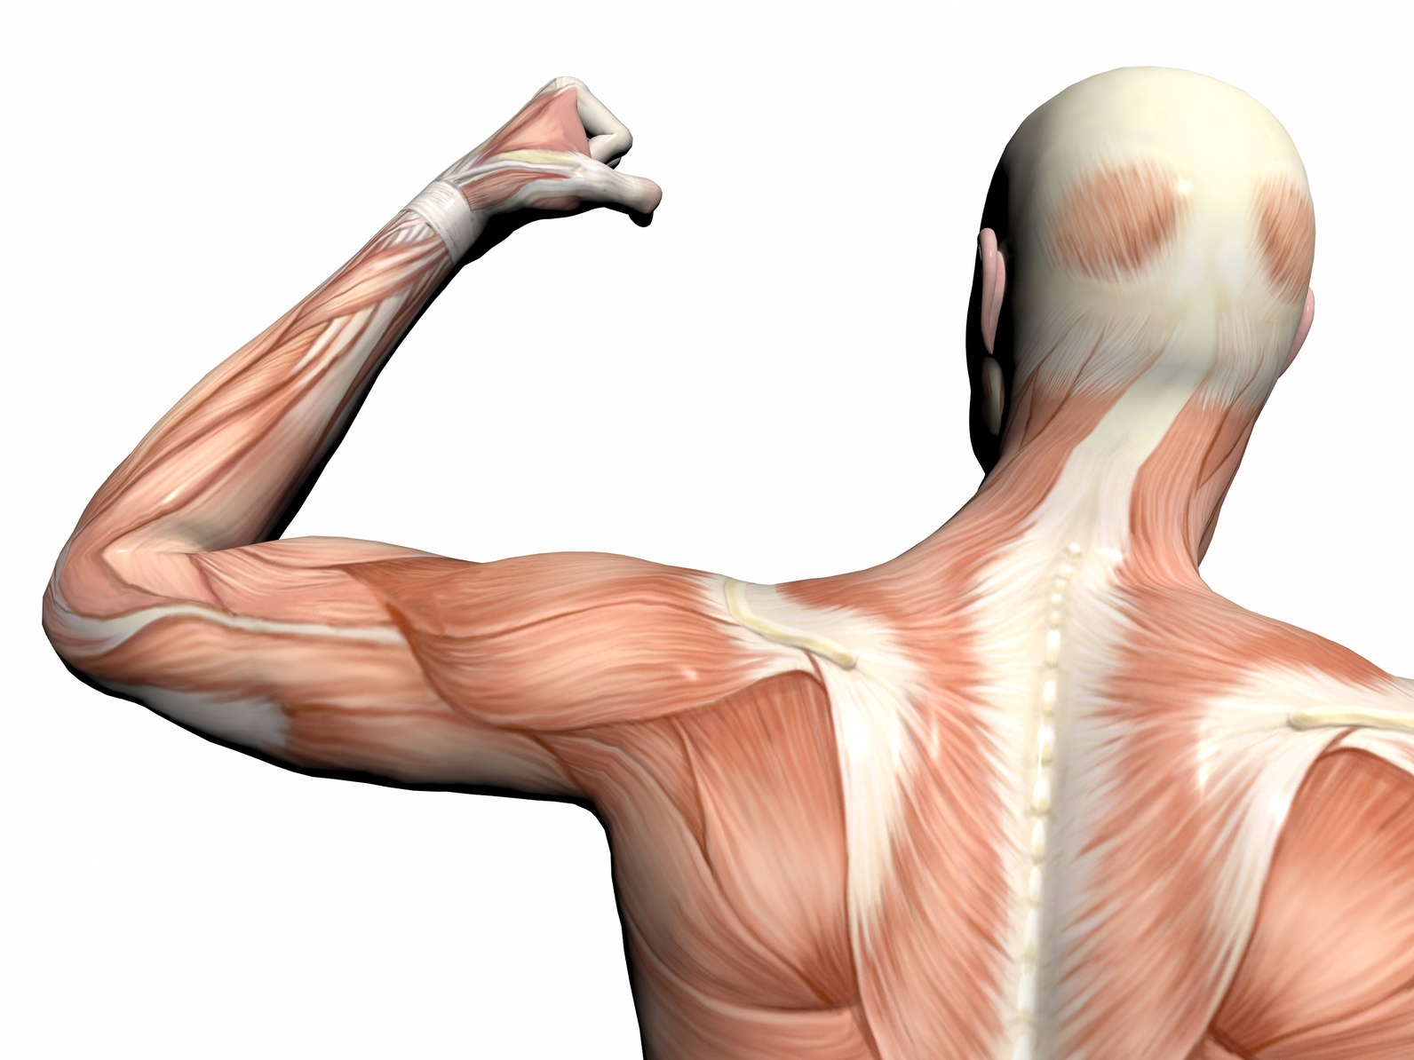
Divisions of Anatomy
Gross Anatomy
Microscopic Anatomy
Cytology
Histology

Slide 8
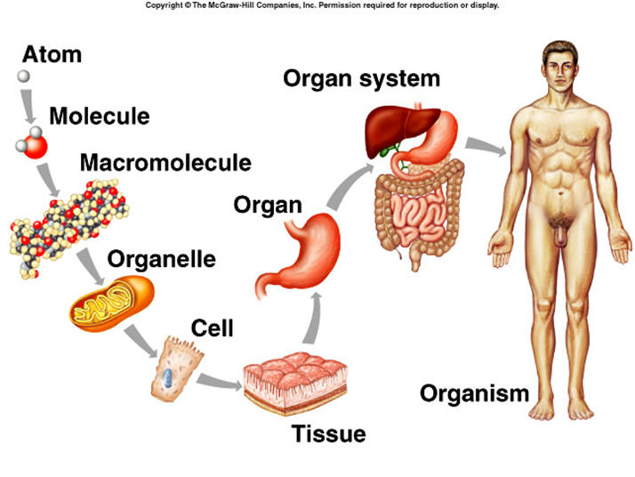
Hierarchy of Organization

Slide 9
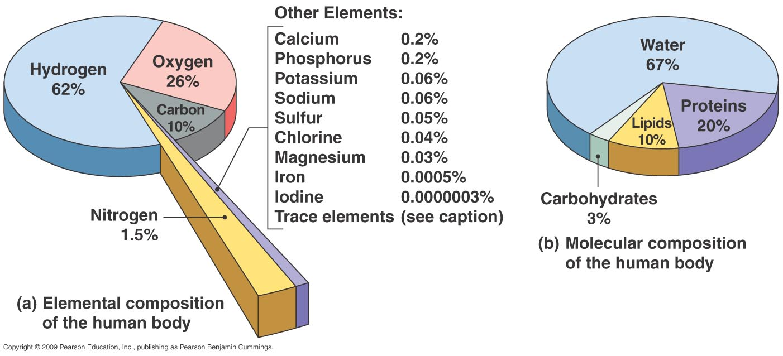
What are you made of ?
Notes:
Why CHO SO IMPORTANT!

Slide 10
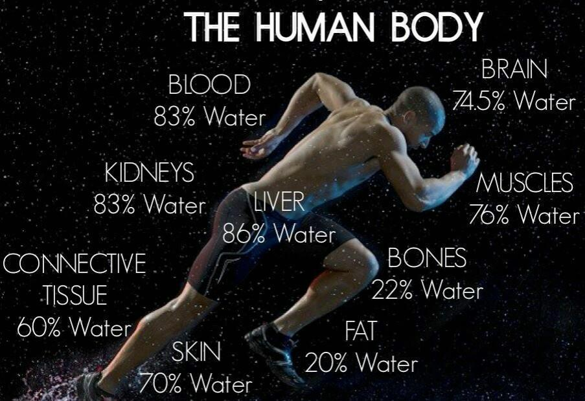

Slide 11
Ways to Study Anatomy
Regional Anatomy – study one region of the body at a time and learn everything about the region
Systemic Anatomy – study one body system at a time. This is the approach we will use in this course

Slide 12
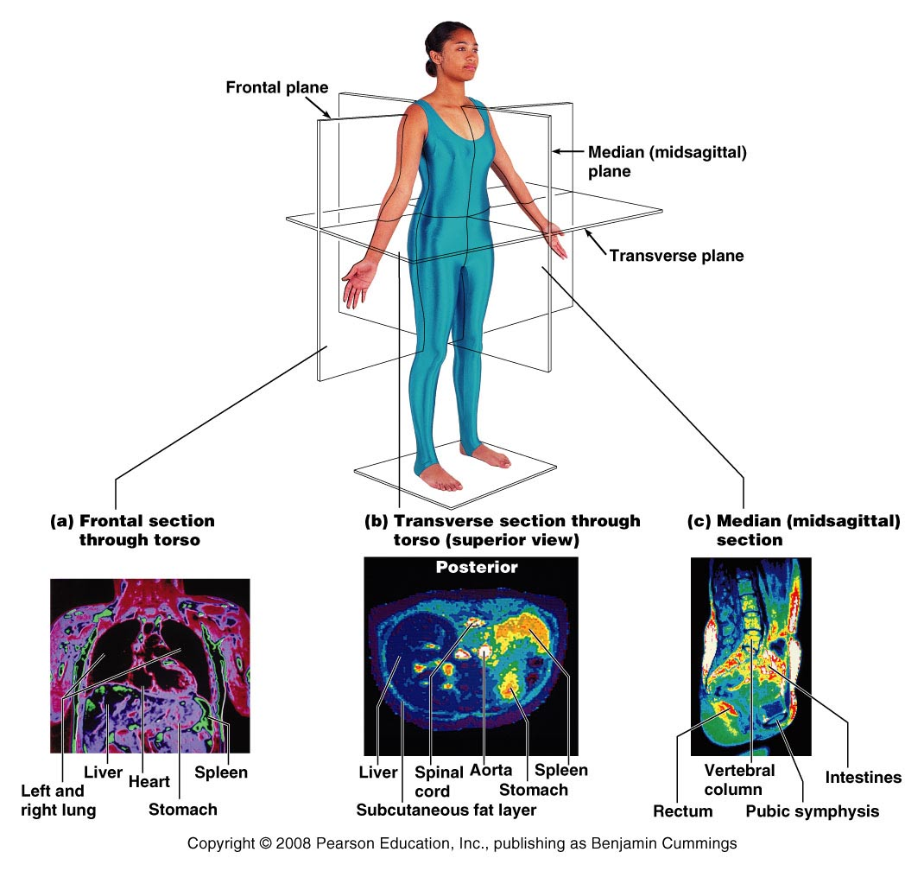
Body Planes and Sections

Slide 13
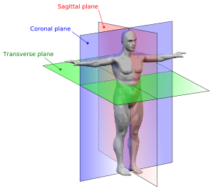
Body Planes
Sagittal – divides the body into right and left parts
(Think of an arrow piercing your heart)

Slide 14
Body Planes
Transverse or horizontal (cross section) – divides the body into superior and inferior parts
(Transverse a Mountain slope, cut across it)

Slide 15
Body Planes
Frontal or coronal – divides the body into anterior and posterior parts

Slide 16
Body Planes
Oblique section – cuts made diagonally

Slide 17
Body Planes
Cross-section or Transverse – divides the into superior and inferior parts
(Traverse a Mountain slope, cut across it)

Slide 18
Body Planes
Longitudinal – plane runs along the axis of a long narrow structure.

Slide 19
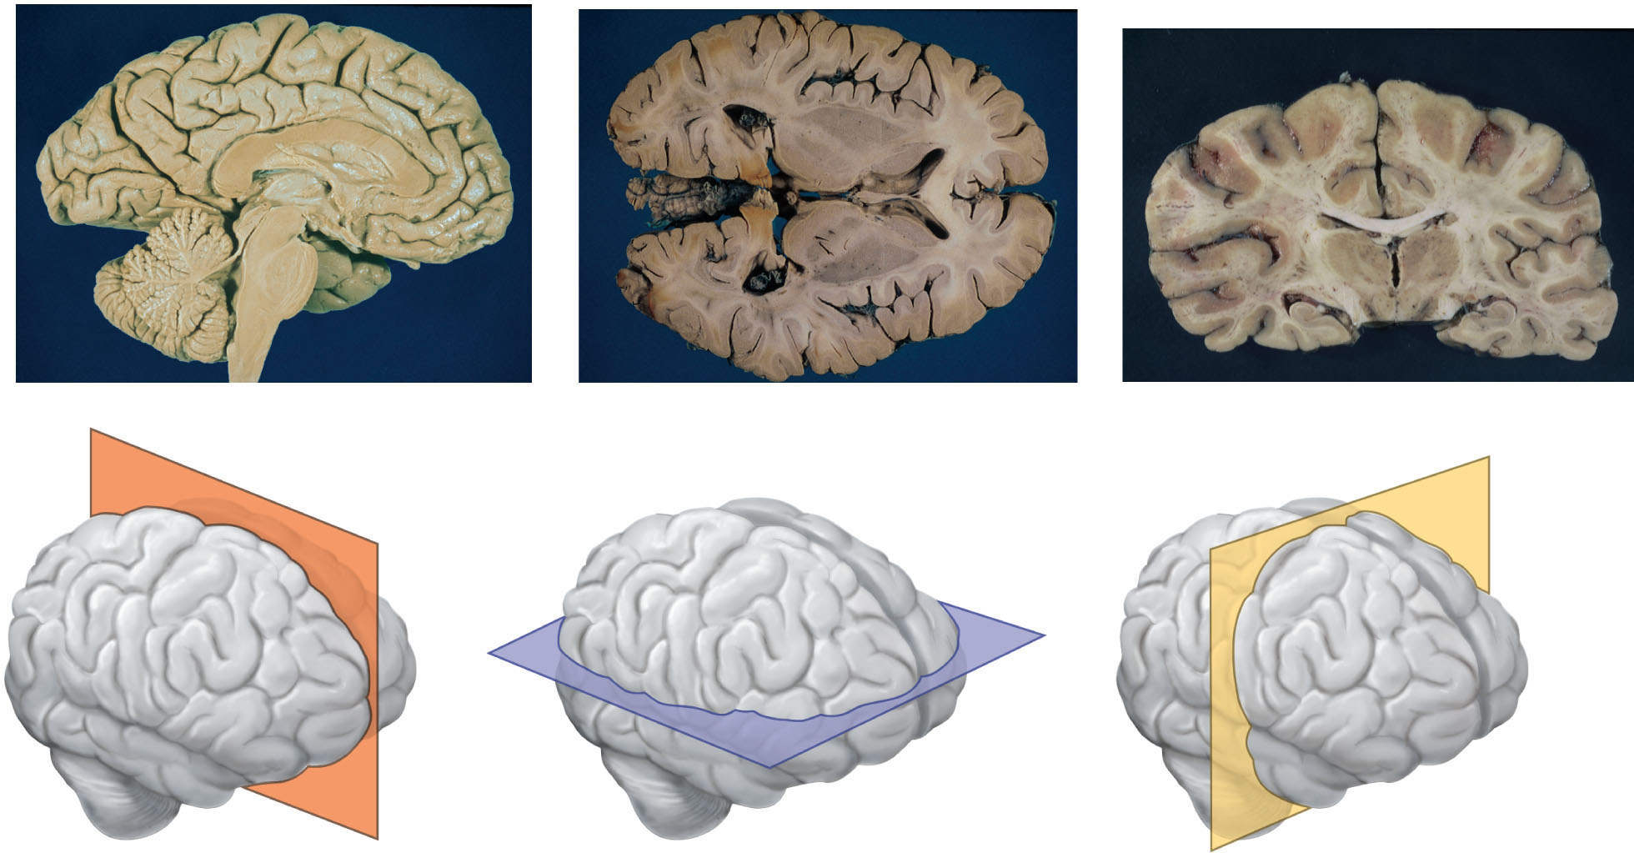
Anatomical Terminology
SAGITTAL
TRANSVERSE
FRONTAL or
CORONAL

Slide 20
Body Cavities

Slide 21
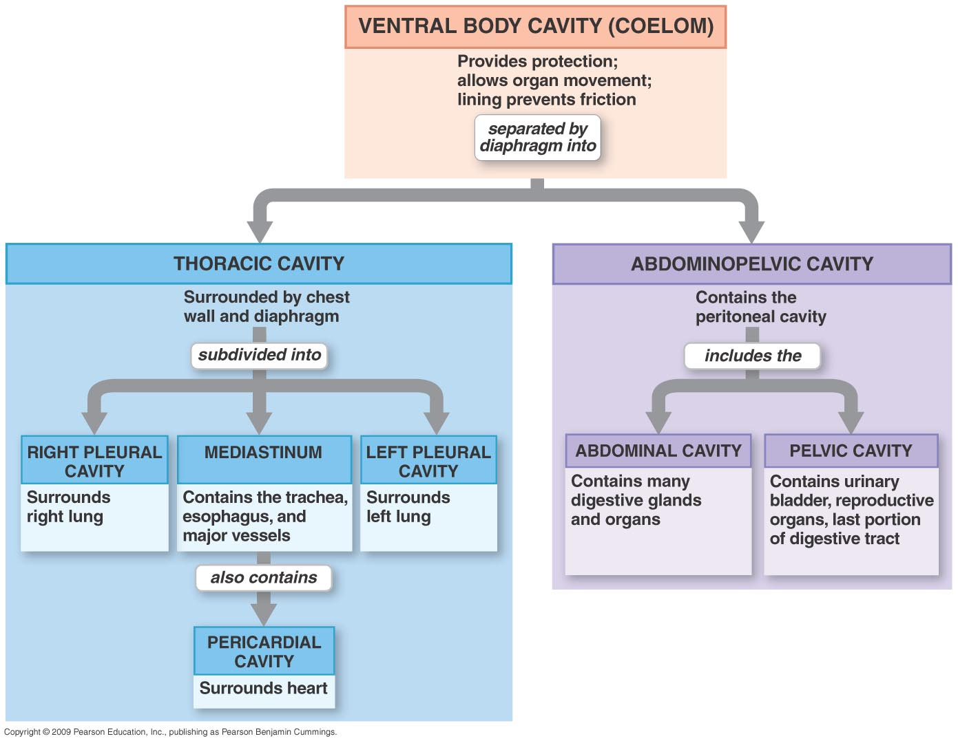
Body Cavities

Slide 22
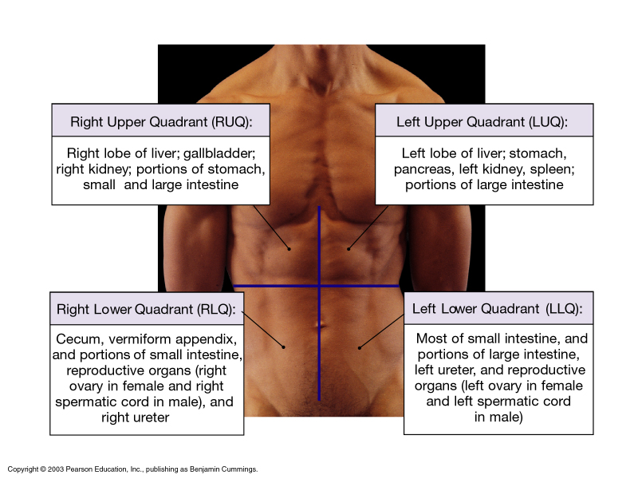

Slide 23
Survival Needs
Nutrients- Carbs for energy, proteins for cell structure, trace elements.
Oxygen- most chemical reactions are oxidative that require oxygen.
Water- 70% body weight. “Universal solvent”
Body temperature- too high = denature proteins and too low = slower reactions
pH- tightly regulated. Blood = 7.35
7.4 = metabolic alkalosis 7.3 metabolic acidosis
Atmospheric pressure- lower at high altitudes
Notes:
Things that must be present for life

Slide 24
Homeostasis
Dynamic equilibrium
Almost all organs function to regulate homeostasis
Achieved mainly through the endocrine and nervous systems
Involve 3 components
1. Receptor- a sensor to monitor and respond to changes
2. Control center- determines set point and determines response
3. Effector- “feedback” to either reduce (negative feedback) or enhance (positive feedback) the effect of the stimulus

Slide 25
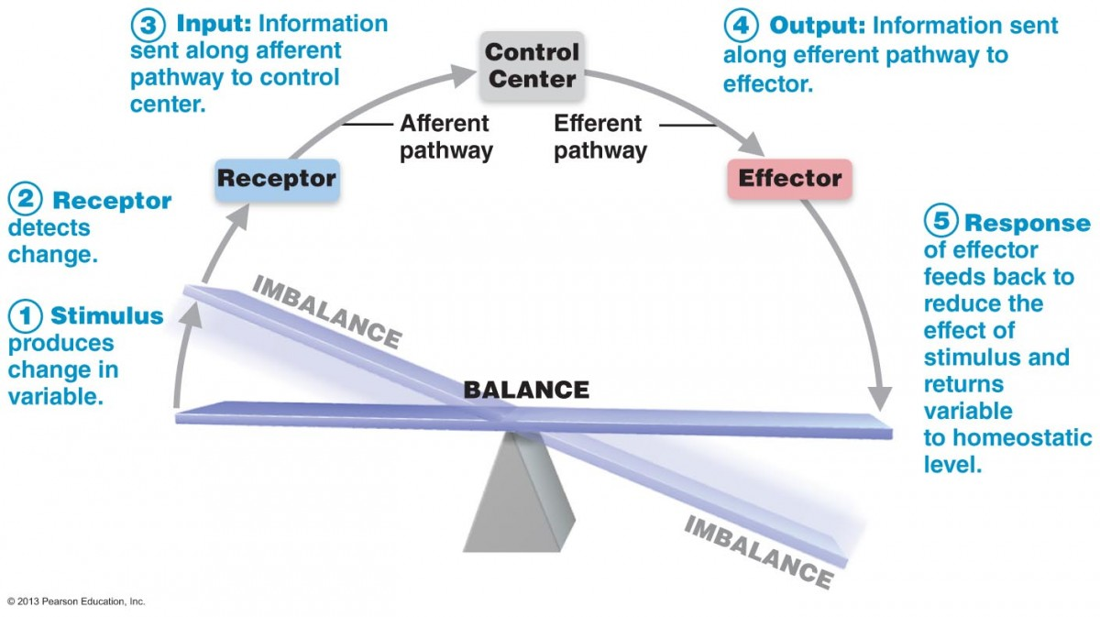
Feedback Mechanisms
Negative
Causes variable to change back to “normal”
Ex. Thermostat
Receptor
Control Center
Effector

Slide 26
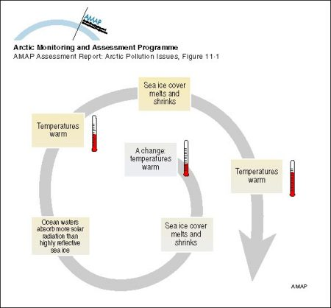
Feedback Mechanisms
Positive
Causes variable to deviate further from original position

Slide 27
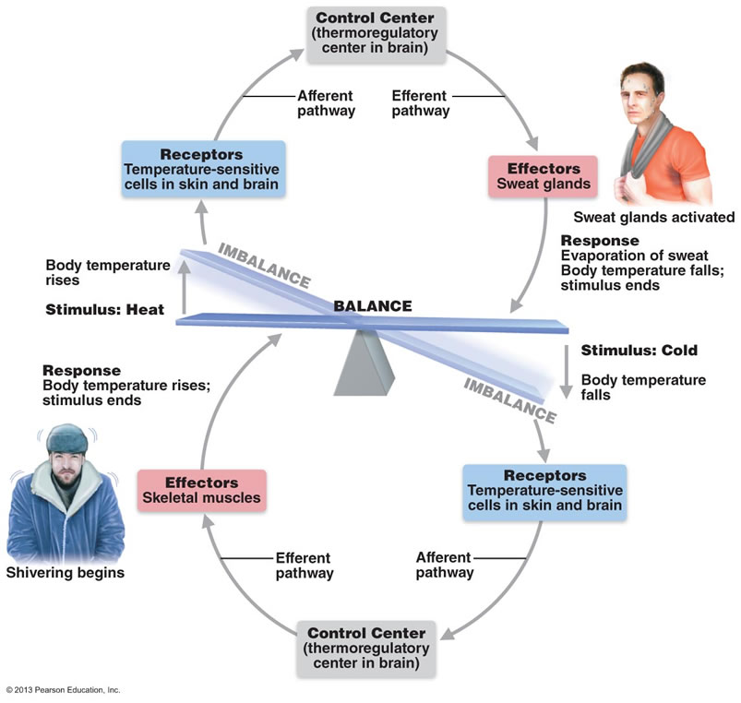

Slide 28
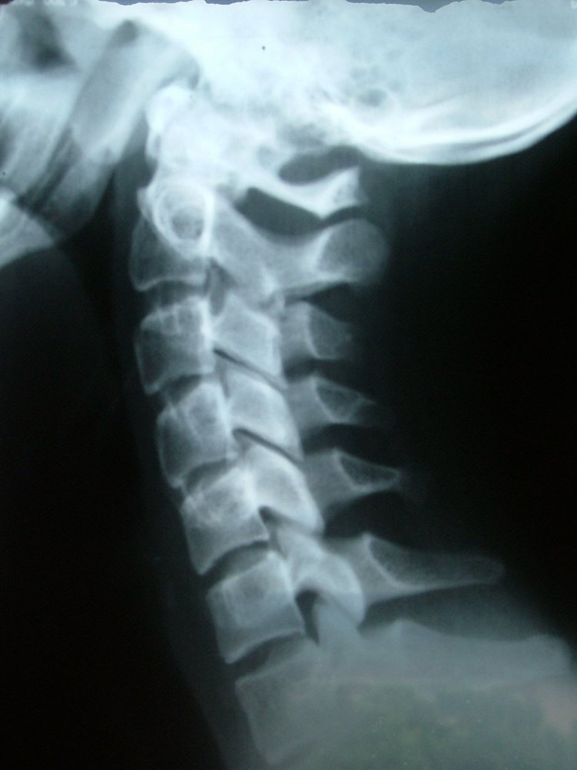
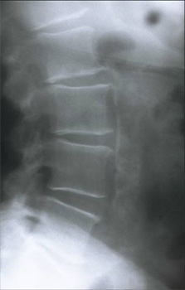
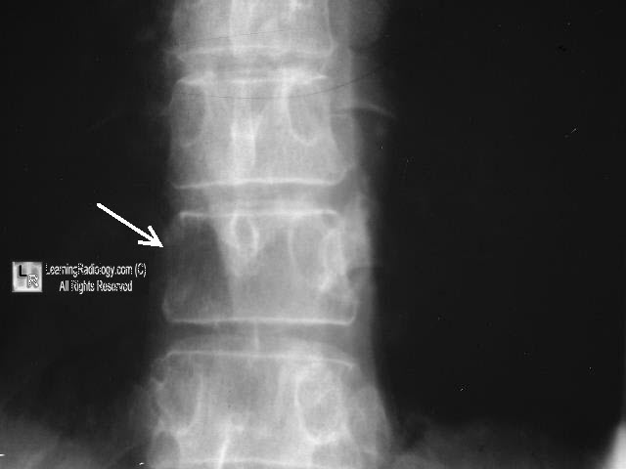
Medical Imaging- X-rays
Dense structures absorb x rays and appear lighter
Best for bones

Slide 29
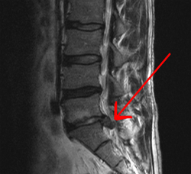
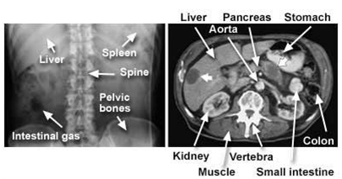
Medical Imaging- CT
Computerized tomography
X ray rotates around patient
Slices through patient

Slide 30
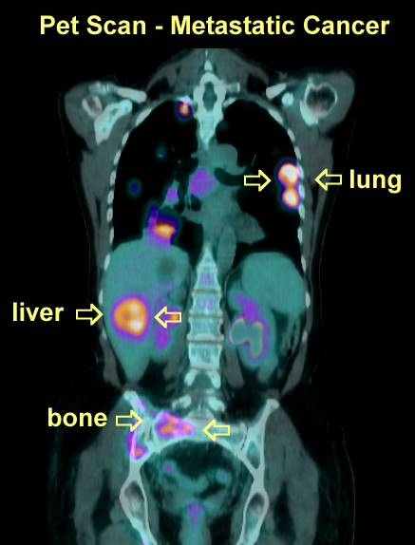
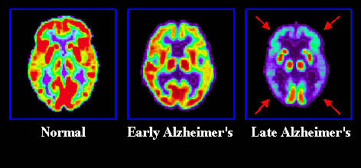
PET scan
Positron emission tomography
Looks at metabolic processes
Brain imaging
Cancer

Slide 31
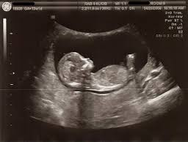
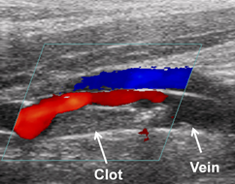
Sonography
AKA: ultrasound

Slide 32
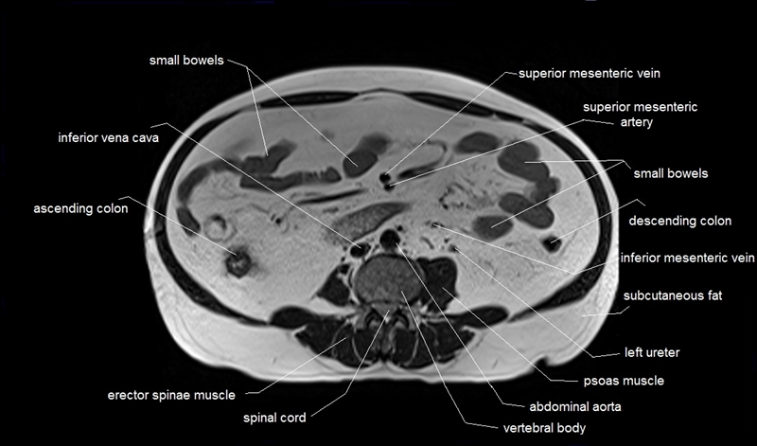
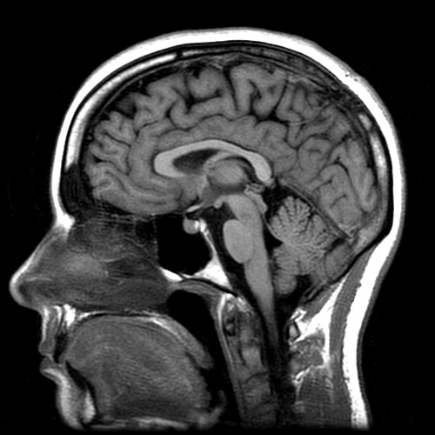
Magnetic Resonance imaging

